Slide 1
Fun Maths Day
May 2014

Slide 2
There are lots of Maths challenges to complete around school today.
Here are some of the challenges you might do:-

Slide 3
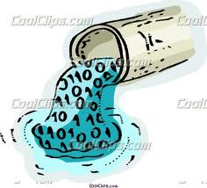
Make the containers full and empty.
Measure how much the container holds.

Slide 4
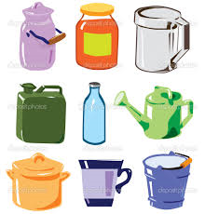
Find which holds the most and test it out.

Slide 5
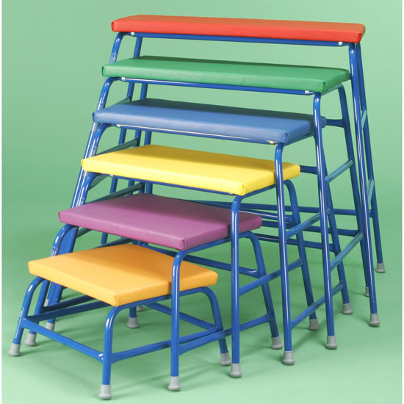
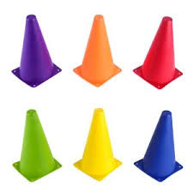
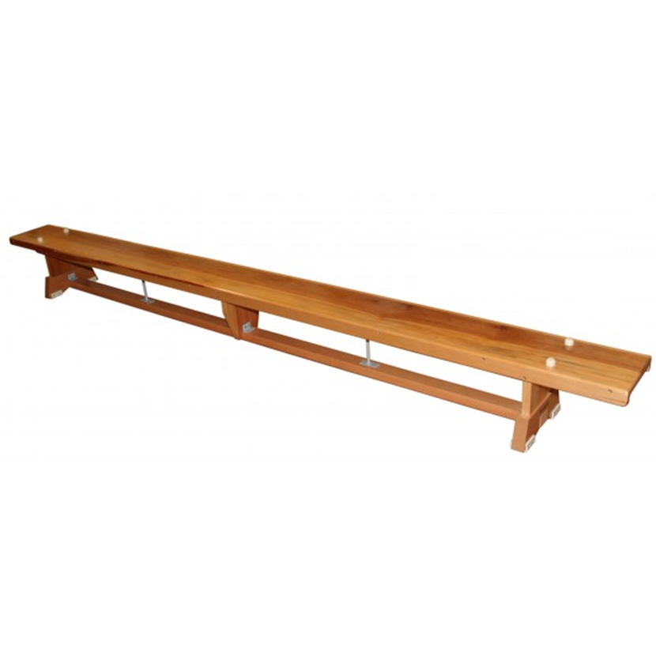
Go ‘over’, ‘under’, ‘around’, ‘on’ equipment in the hall.

Slide 6
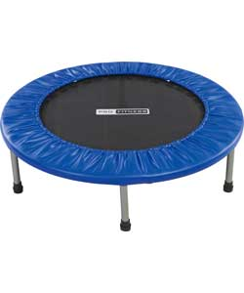
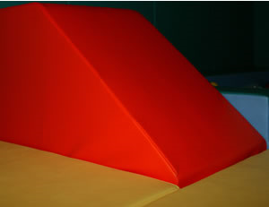
Jump on the trampette then go on the slide.
Or make up your own sequence of movements and show your class.
Which order did you use the equipment in? What did you do first, second, third?

Slide 7
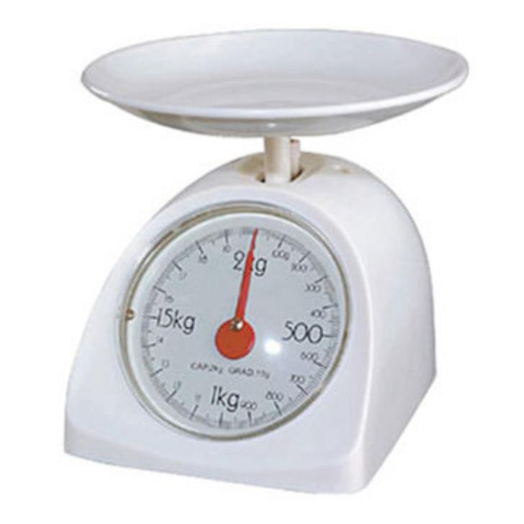
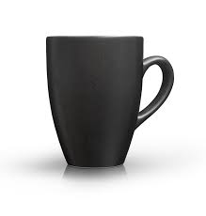
Measure using cups or using the scales.

Slide 8
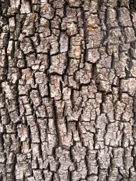
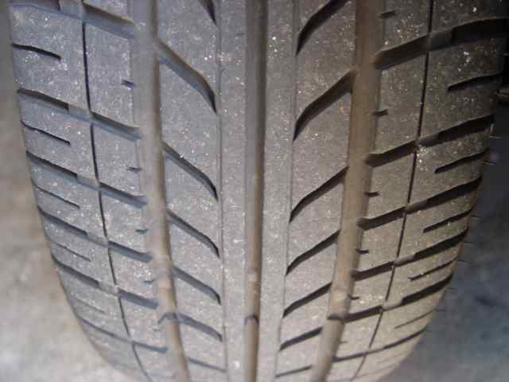
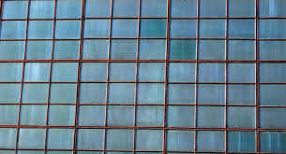
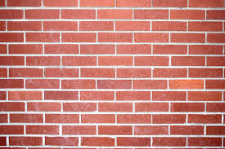
Search for patterns.

Slide 9
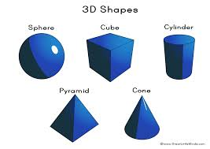
Search for shapes all around.
Can you see different shapes around school and in the playground?
Is it a 2D shapes or 3D shape?
How many different shapes can you find?

Slide 10
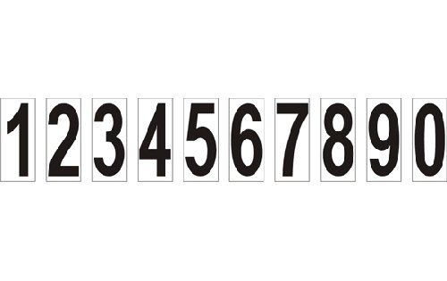
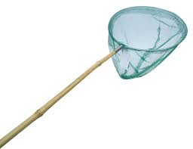
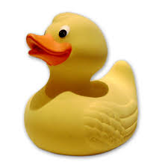
Catch a duck.
Which number is on your duck?
Can you catch two ducks and add the numbers together.

Slide 11
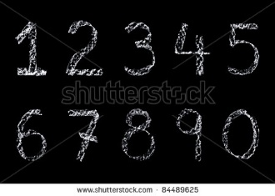
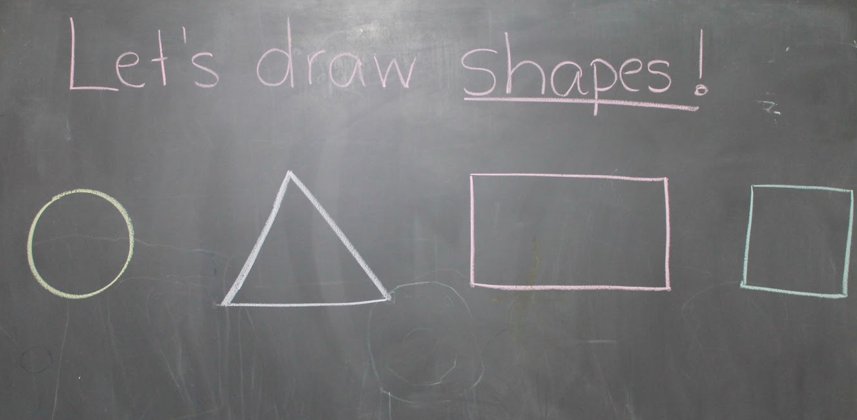
Draw your own numbers and shapes.

Slide 12
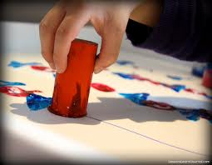
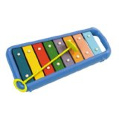
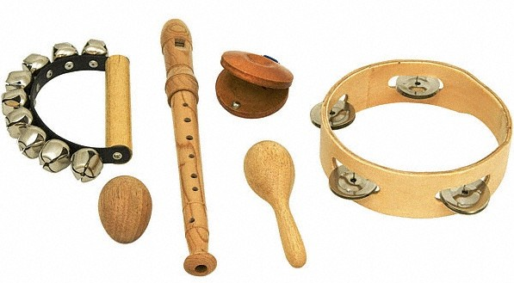
Make your own patterns.

Slide 13
But most have all have FUN!

