Slide 1
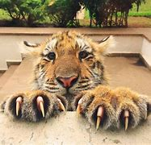
They are near the top of the food chain and are feared and respected by all they encounter. Read about the tiger's adaptations that give it this well deserved reputation.
Tigers are Top Hunters
Their roar can send chills through your body. Their razor sharp claws can cut through flesh like a knife cutting through butter. Their pounce will take you down with one leap. These giant cats we call tigers are dominant and respected predators in their environment. Let's learn about the adaptations that allow them to be one of the most efficient hunters on the planet!

Slide 2
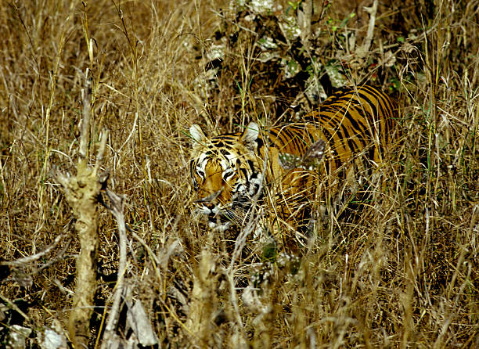
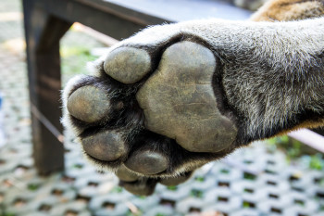
Sharp Senses and Sneakiness
Imagine a plump wild boar grazing peacefully near the edge of the dense jungle as night is almost upon him. Little does he know, there is a dangerous tiger quietly watching him in the tall grass. Her excellent hearing and vision, especially at night, helped her find the boar as he was chomping down on his dinner of grass and insects.
They are both mostly nocturnal animals but the boar does not see the predator. Her striped body is similar to the setting sun's sunlight patterns shining through the grass and trees, which allow her to be camouflaged, meaning she blends in. As she crouches in an ambush style of hunting and slowly inches toward the boar, he does not hear her because she has thick padded feet, which give her the ability to move without making a sound.

Slide 3
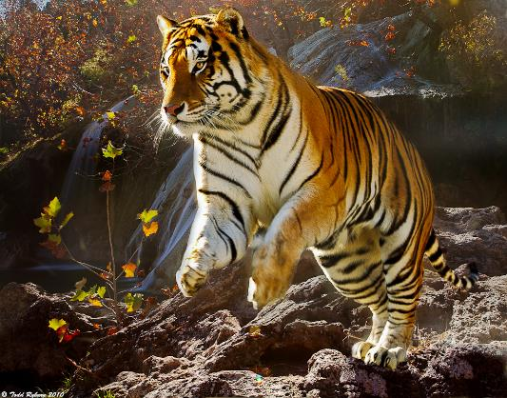
Built for Pouncing
But, the tiger steps on a dried up leaf that crunches under her foot. The boar immediately senses danger and the chase begins. The tiger's fast muscular body is quickly gaining on the boar so he runs faster. But, he is no match for the tiger's pounce. The tiger's flexible spine and long legs allows her to pounce several meters, in which she lands right on top of the boar. Her body size, strong grip and razor sharp claws knock the boar off balance, then she pins the boar down and chomps down with her sharp teeth. The hunt is complete.
The tiger's adaptations of having nocturnal habits, striped camouflage, excellent vision and hearing, sharp teeth and claws, a flexible spine and the ability to quietly and quickly pounce on a predator are the tiger's biggest advantages to remaining alive on our planet.

Slide 4
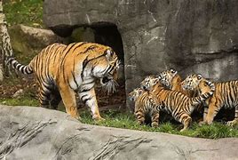
Home Life Behaviour
Tigers, like house cats, are happy to live mostly in solitude, which means being alone, and they are very independent. Just as a house cat will efficiently hunt down a mouse and kill it all by itself, tigers hunt alone most of the time. Hunting in solitude is an adaptation because tigers can be sneakier if they are alone.
The mothers raise and protect the cubs without the male tiger's help. She stays with them for a few years, and teaches them how to survive and hunt. Then the cubs leave their mom, and find their own territory to live and hunt in.
Tigers are also very territorial, meaning they want to have their space all to themselves. They will have several dens in the dense forest, in caves or in other hollowed out areas. This adaptation gives them multiple areas of protection from danger.

Slide 5
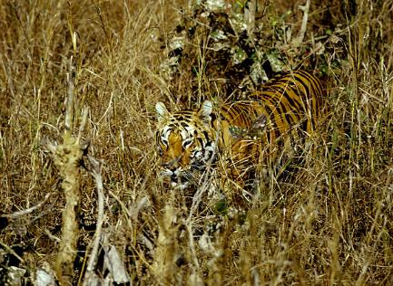
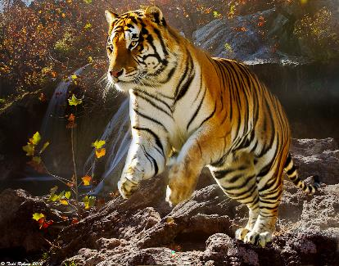
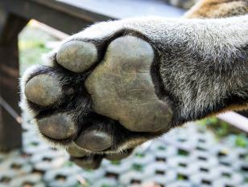
Summary
The tiger's many physical and behavioural adaptations have allowed it to become a fierce and dominant predator. Their camouflage allows them to blend in to sneak up on their prey, and their strong body helps them pounce on their meal. This nocturnal, hunting animal likes to live in solitude but is also a nurturing mother who raises her cubs for years.

Slide 6
Animal Adaption Fact Card
Writing Frame

Slide 7
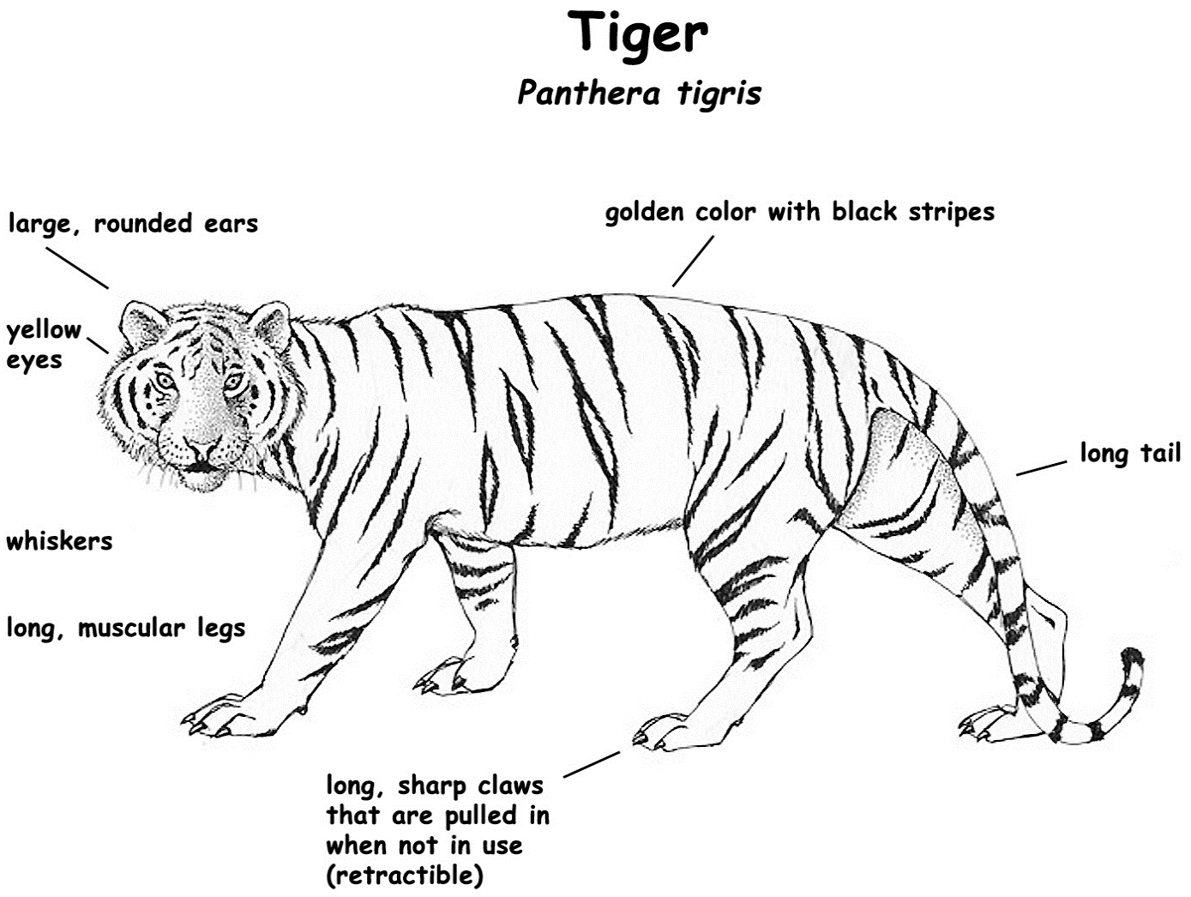

Slide 8
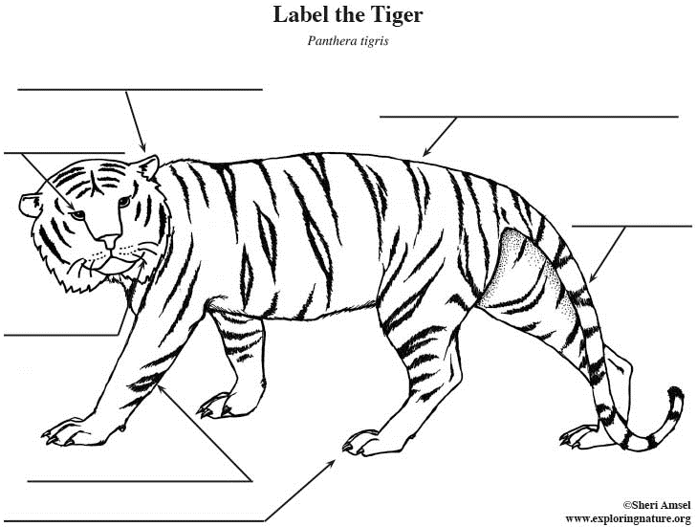

Slide 9
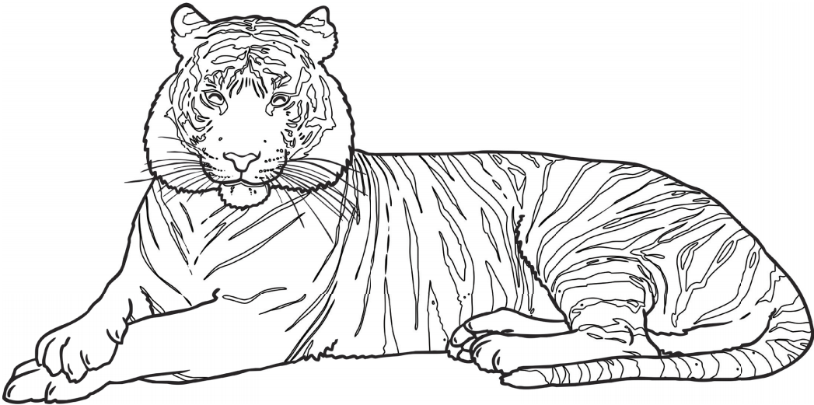
Bengal Tiger

Slide 10
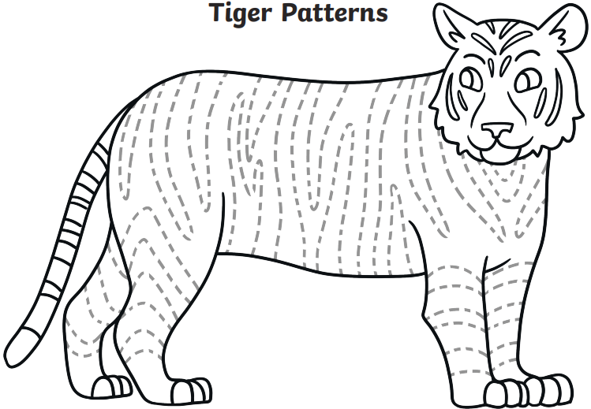

Slide 11
