Slide 1





Supporting your child's emotional regulation
An introduction for parents
Presented by
Mental Health School Teams
Notes:
Welcome and introductions.
No camera/chat functions due to wanting to limit any safeguarding concerns.
45 minutes

Slide 2

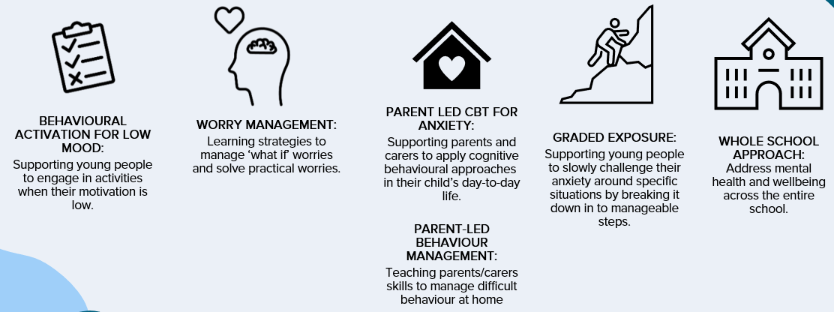
Who are we?
Mental Health Support Teams (MHST) are an NHS service providing mental health support to primary schools and secondary schools in St. Helens, Warrington, Knowsley and Halton.
We aim to help young people learn strategies and new ways of caring for their mental wellbeing.
We provide interventions to pupils struggling with anxiety, low mood or behavioural difficulties.
..and deliver talks like these!
Notes:
At the end of the presentation there will be the QR codes to take them to their local MHST webpage – from there you can see if your child attends one of the schools we work in. If they do, speak to their school who can look at referring into our service.

Slide 3

Children and Feelings
Up until adolescence (and beyond for some) children may need support from the adults around them to manage their feelings appropriately
Children develop a basic understanding of emotions by around 6-9 years old, but it can take much longer to learn how to ‘regulate’ or control these emotions
This is why traditional ‘talking therapy’ doesn’t work so well with younger children (primary aged)
Until they have this, they are likely to show how they are feeling in what they do rather than what they say (their behaviour)
Notes:
So thinking about how that might present - Children develop a basic understanding of emotions by around 6-9 years old, they might be able to use some emotional words and describe emotions experiences - but it can take much longer to learn how to ‘regulate’ or control these emotions, or describe how they are feeling when distressed.
This is why traditional ‘talking therapy’ doesn’t work so well with younger children (primary aged) and why we offer support to parents/school rather thanw working with the yp where the yp might have a really nice time in 1-1 but they cant retain the information and apply it when under pressure.
Up until adolescence (and beyond for some) children will need support from the adults around them to manage their feelings, particularly those that have experienced adverse experiences or neurodiversity.
Until they have this, they are likely to show how they are feeling in what they do rather than what they say (their behaviour)

Slide 4
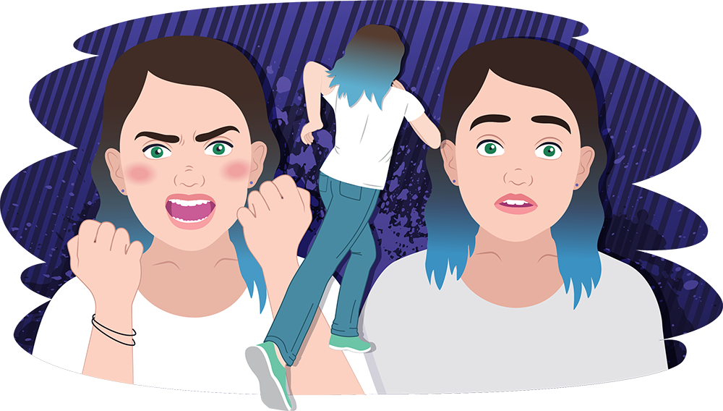
What is emotional Regulation?
The ability to manage your emotions:
  To calm yourself down when you feel upset
  To adjust to change in expectations
  To handle frustration (without an outburst)
  To experience strong emotions without being overwhelmed by these
Notes:
At the end of the presentation there will be the QR codes to take them to their local MHST webpage – from there you can see if your child attends one of the schools we work in. If they do, speak to their school who can look at referring into our service.

Slide 5
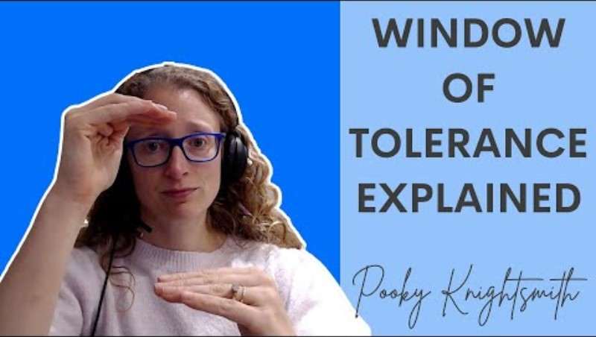
Window of Tolerance
Notes:
At the end of the presentation there will be the QR codes to take them to their local MHST webpage – from there you can see if your child attends one of the schools we work in. If they do, speak to their school who can look at referring into our service.

Slide 6


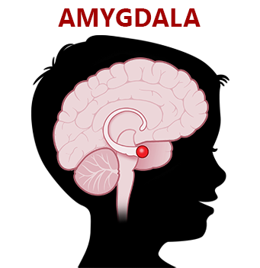


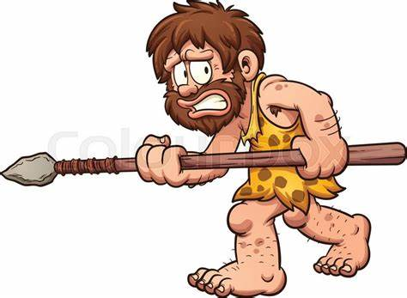
Fight, Flight, Freeze Response
When in fight mode, children may react in a way that we see as aggressive:
Hitting out
Throwing things
Shouting
Swearing
Hurting self
Fighting with peers
When in flight mode, children may react in a way that we see as avoidant:
Pleading to leave a situation or walking/running away
Feigning illness to avoid leaving home
Escaping to a perceived safe place e.g. the bathroom, bedroom, to a caregiver
When in freeze mode, children may react in a way that we see as ignorant or rude:
Refusing to answer questions/participate in family activities
Hiding under/behind furniture
Refusing to get out of the car
Refusing to leave caregivers

Slide 7
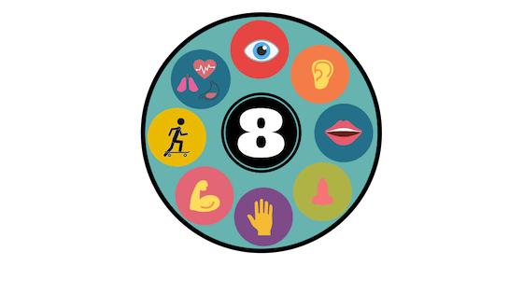
Sights
Sensory Systems
Internal body awareness
Sound
We ALL have sensory sensitivities.
Some children are more sensitive than others.
When we are stressed, our senses become heightened
Movement
Taste
Body Awareness
Smell
Touch
Oversensitive
- AVOIDS
Under sensitive – SEEKS
Notes:
At the end of the presentation there will be the QR codes to take them to their local MHST webpage – from there you can see if your child attends one of the schools we work in. If they do, speak to their school who can look at referring into our service.

Slide 8
Signs of emotional dysregulation
Oversensitive
- AVOIDS
Under sensitive – SEEKS
If your child over-responsive, they are avoiding sensory (they NEED less):
excessively covering ears at loud noises
Hiding themselves away
Avoiding touch
Extreme “picky” eating
If your child under-responsive, they areseeking sensory (they NEED more):
-repetitive body movements
Touching lots of things
Making sounds
Chewing non-food items

Slide 9
Strategies to support

Slide 10
Supporting sensory dysregulation
Oversensitive
- AVOIDS
Under sensitive – SEEKS
If your child over-responsive, they are avoiding sensory (they NEED less):
Calming activities
Breathing exercises
Variety of activities to slowly increase comfort levels
If your child under-responsive, they are seeking sensory (they NEED more):
Brain breaks
Fidget toys
Heavy bag/weighted blankets
Sensory toys to stimulate

Slide 11
Supporting sensory dysregulation
Smell/ Taste
Smell spices
Blow bubbles
Essential Oils
Eat frozen/ warm foods
If we try and keep children calm all the time, this will not work
Children go up and down their window of tolerance naturally
They need access to both ‘alerting’ or exciting activities, as well as ‘calming’ or soothing activities
It can be helpful to develop a routine where you alternate between calming and alerting activities throughout the day (also sometimes called a ‘sensory diet’)
There might be periods of the day where children need more calming (e.g., start of the school day) and more alerting (before thinking tasks)
Touch/ pressure
Stroke dog/cat
Massage
Use fidget spinner
Bear Hug
Circuits
Star Jumps
Movement/ body awareness
Run
Yoga
Rocking chair
Safe space – dark tent
Look at nature
Looking/vision
Lava lamps
Dot to dot
Listening/ Auditory
whispering
Blow whistle
Bang on pots and pans
Listen to favourite music

Slide 12
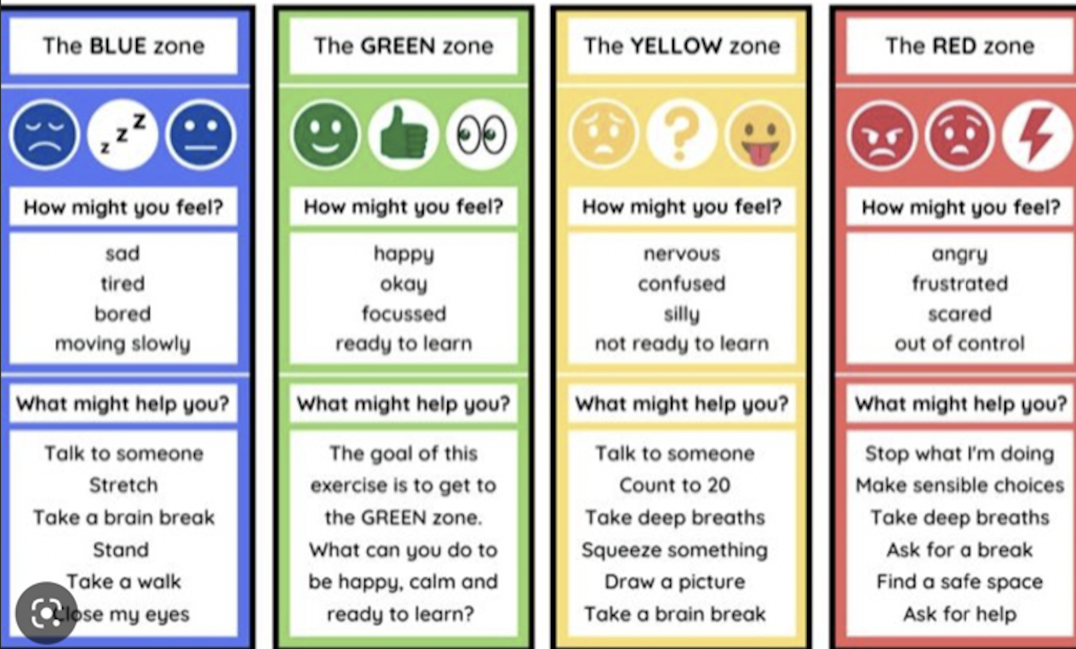
Use the zones of regulation as a family at home.

Slide 13
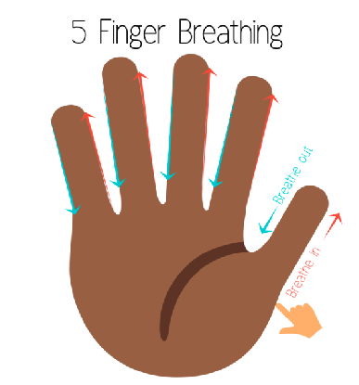

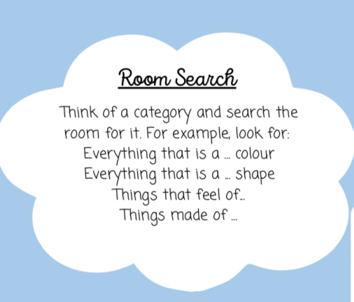
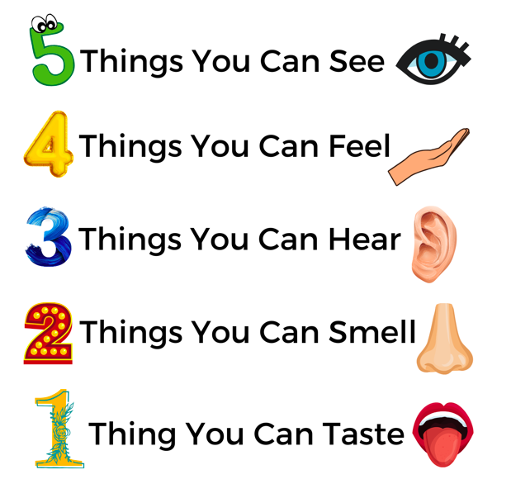
Helping your child relax
Mindfulness Colouring
Breathing techniques
Grounding techniques
Meditation
Movement

Slide 14
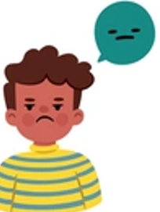
Amber Strategies
For when stress or emotional arousal is starting to build
Reduce demands (can you all pause for a moment?).
Distract and redirect where you can (to a favoured activity or a soothing activity).
Simplify speech – use language that shows acceptance, empathy and curiosity.
If they know relaxation techniques – use these now.
Remove any ‘triggers’ if possible (sensory things, other children, demands).
Plan for tricky times of the day (e.g. when you are busy or just coming in from school) by having activities ready for them.
Plan for tricky activities by having an ‘emotional first aid kit’ or ‘soothing box’ available for them to access.
Notes:
At the end of the presentation there will be the QR codes to take them to their local MHST webpage – from there you can see if your child attends one of the schools we work in. If they do, speak to their school who can look at referring into our service.

Slide 15
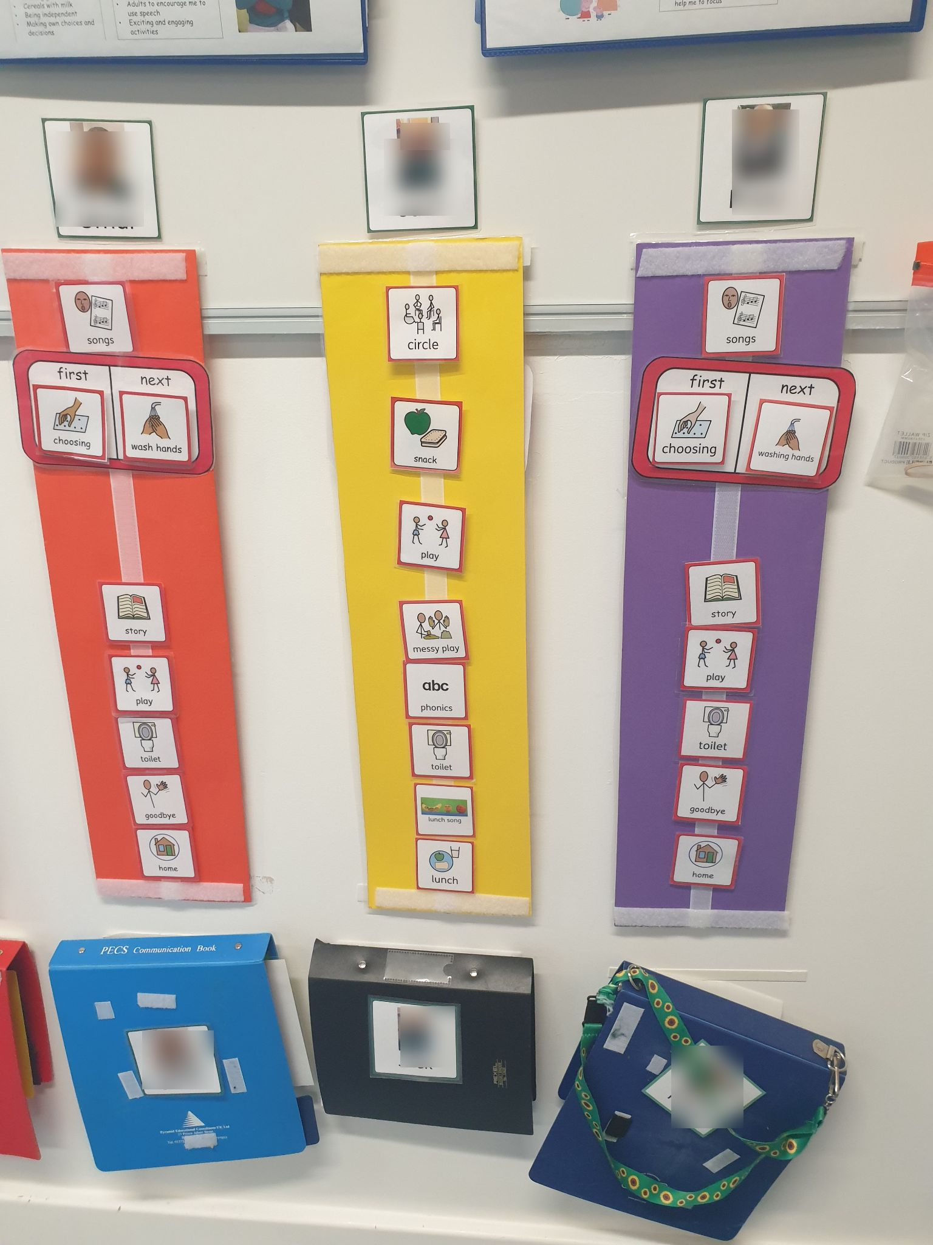
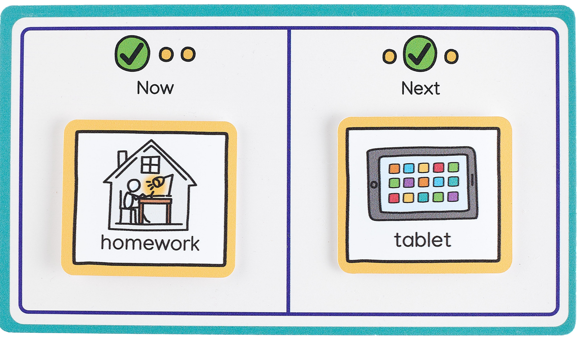
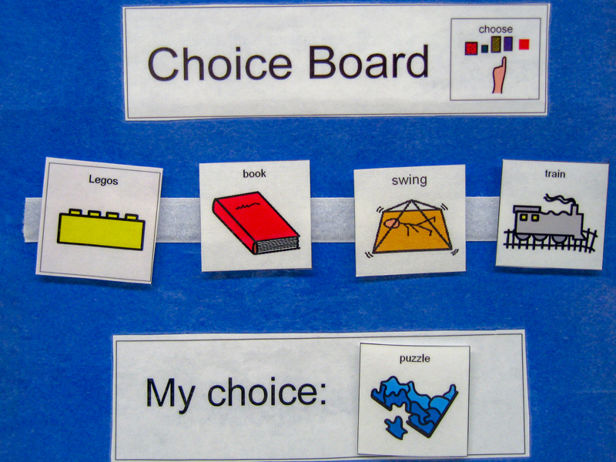
Use visual aids
Notes:
At the end of the presentation there will be the QR codes to take them to their local MHST webpage – from there you can see if your child attends one of the schools we work in. If they do, speak to their school who can look at referring into our service.

Slide 16
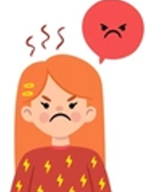
For when stress has reached a peak or ‘crisis’
Have someone stay available (big feelings are scary)
Keep a calm tone of voice and body language (even if you don’t feel it inside).
Tell them what you do want them to do rather than don’t want them to do (e.g. “hands down” rather than “don’t hit” or “take some deep breaths” rather than “don’t panic”).
If anxious, do not try to reason with them or challenge the fear – use 3Rs.
Remove other people or make the environment safe.
Use simple, reassuring statements such as “I am here”, “you’re ok”
Use any strategies the child responds to for regulation.
Reactive Strategies
Notes:
At the end of the presentation there will be the QR codes to take them to their local MHST webpage – from there you can see if your child attends one of the schools we work in. If they do, speak to their school who can look at referring into our service.

Slide 17
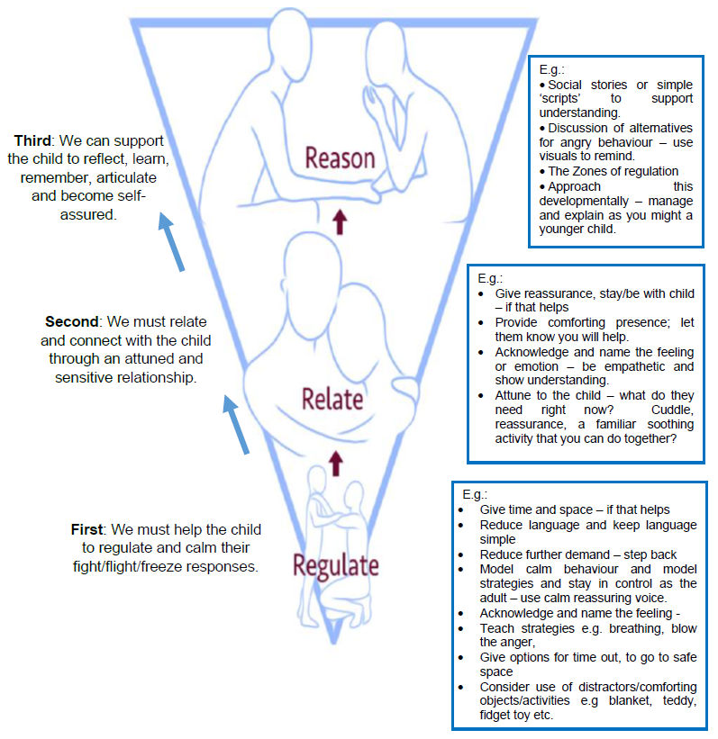
The Three R’s
  Dr Bruce Perry - Reaching the learning brain:
  Help the child to regulate and calm their FFF response
  Relate and connect with the child through an attuned and sensitive relationship
  Support the child to reflect, learn, remember, articulate and become self assured
  Heading straight for the ‘reasoning’ part of the brain with an expectation of learning will not work well if the child is dysregulated and disconnected from others.
Notes:
At the end of the presentation there will be the QR codes to take them to their local MHST webpage – from there you can see if your child attends one of the schools we work in. If they do, speak to their school who can look at referring into our service.

Slide 18
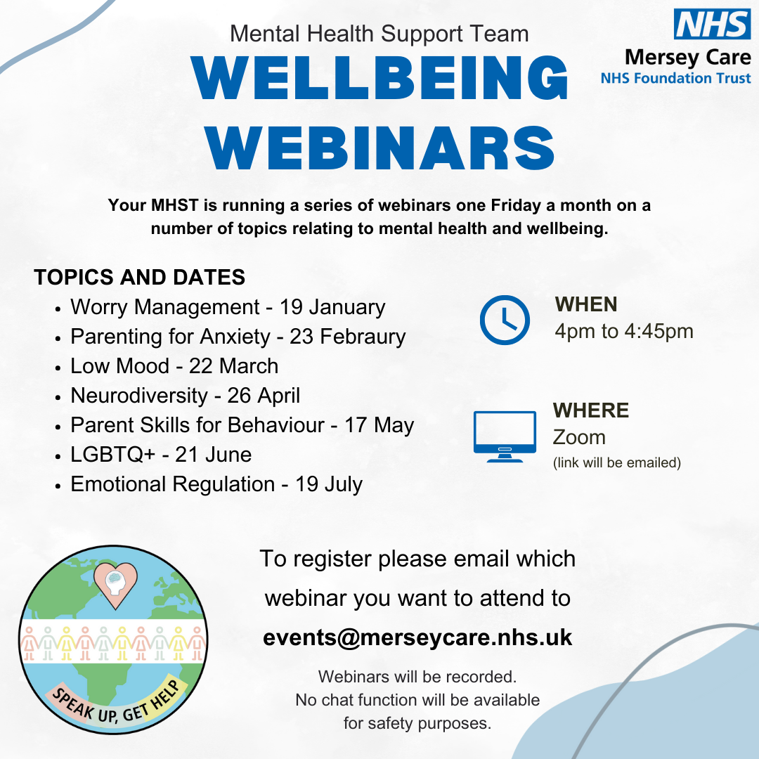
General wellbeing strategies and support
Spending time with friends and family
Eating a healthy diet
Spend time doing things you enjoy
Exercise (doesn’t have to be a gym) a walk can be just as good!
Speak up and get help
Good sleep
This goes for you too!

Slide 19

Self-regulation as parents
It is important to also think about your own needs.
Having a sensitive or distressed child at home can be very demanding.
We also need to think about how you look after yourself.
Halton SEND parent carer forum
Carers Centre
Short breaks team
Young minds parent helpline: 0808 802 5544
Adult IAPT services
ADDvanced solutions - 0151 486 1788
Mind - mind.org.uk
NHS - nhs.uk/nhs-services/mental-health-service
Notes:
At the end of the presentation there will be the QR codes to take them to their local MHST webpage – from there you can see if your child attends one of the schools we work in. If they do, speak to their school who can look at referring into our service.

Slide 20
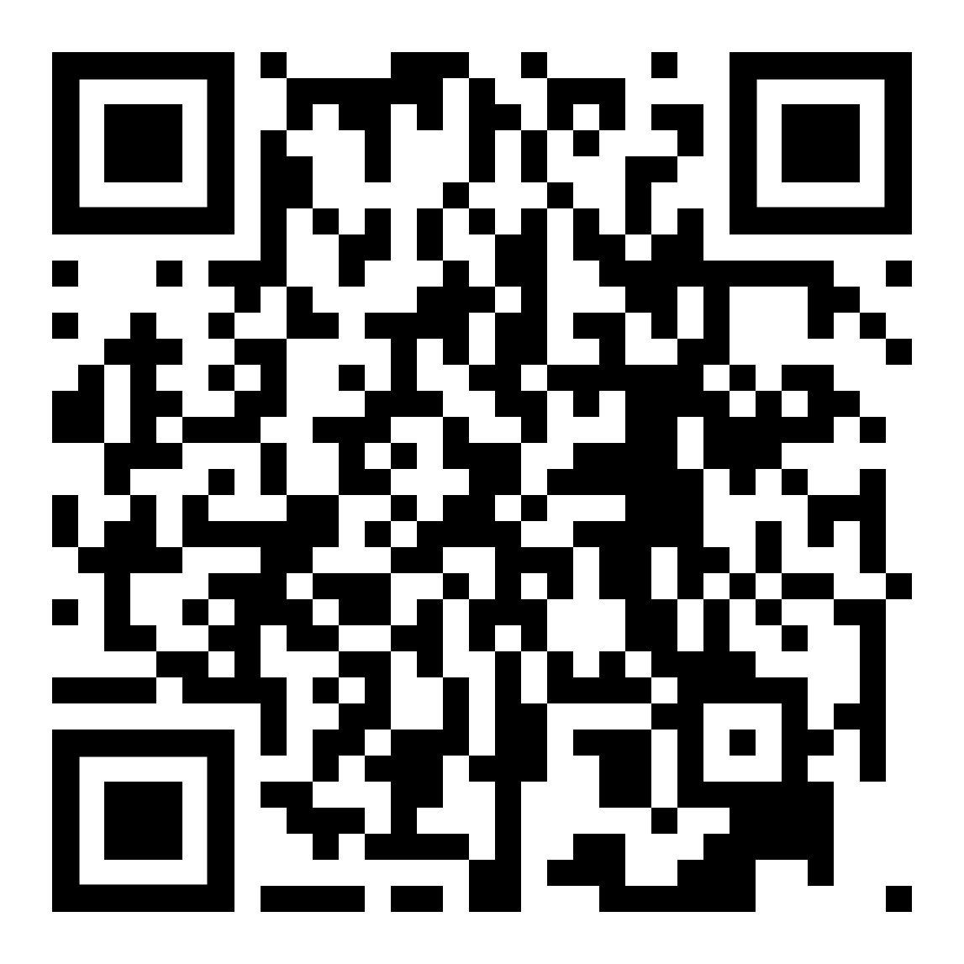
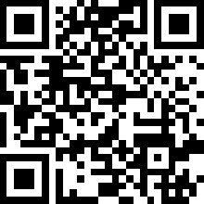
Support for Young People
Halton CAMHS – 01928 568 162
CAMHS 24/7 response team – 01744 415 640
MHST website
Self-help workbooks

