Slide 1



Family Support at Brookfields School
Notes:
School = learning. Can’t learn unless emotionally stable – what kind of night’s sleep / medical conditions / sensory stimulation / communication / anxiety / etc. Children with additional needs have to cope with a range of factors that can affect their emotional state. So do their parents! Support extended.

Slide 2

Network, Network, Network!
Having a child with additional needs can be a steep learning curve – new terminology / millions of appointments / different professionals / no sleep!
Carers Centre – newsletters, Young carers, learning opportunities, wellbeing sessions.
Cheshire Autism Practical Support (ChAPS) – family activities & workshops.
Disabled Childrens’ Services – short breaks support & family activities.
Brookfields School – Parents’ Group, monthly workshops, WhatsApp group, Coffee Mornings.
Facebook, School website (Family Support), Local Offer website.
Notes:
No 2 children are the same, but sharing challenges and solutions with other parents informs your own parenting. Networking gives you insight into other parents’ experiences and often gives you new ‘leads’ in supporting your child. New club in the area / use a service you have just been referred to / have info about a funding option for new equipment for your child / been on a holiday that was particularly SEN friendly. There will always be something new for you to learn as your child’s needs progress / change.

Slide 3

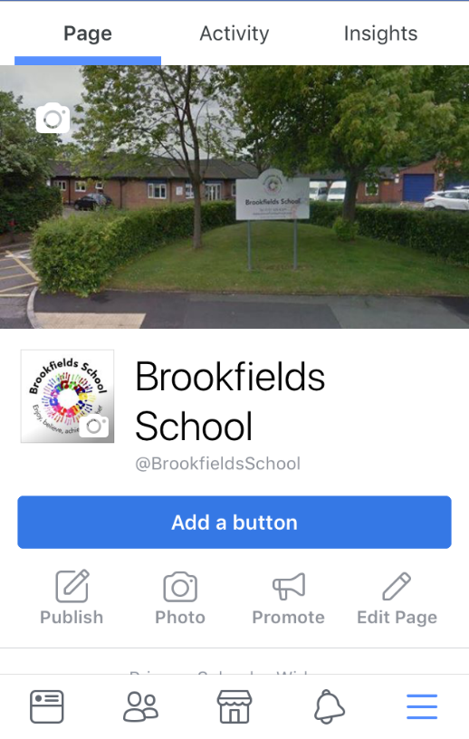
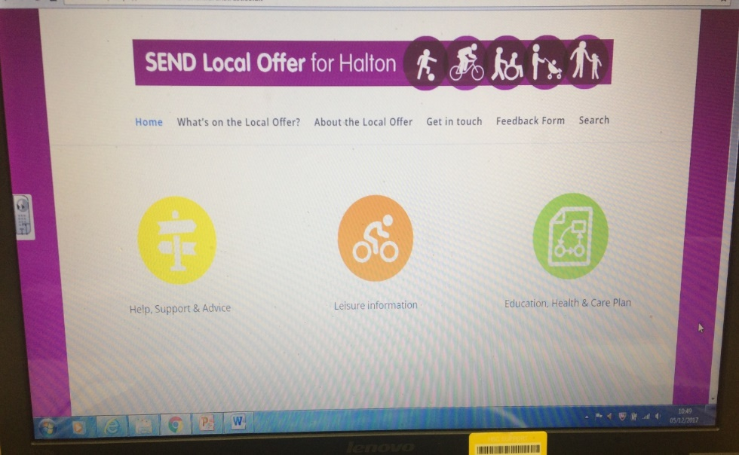
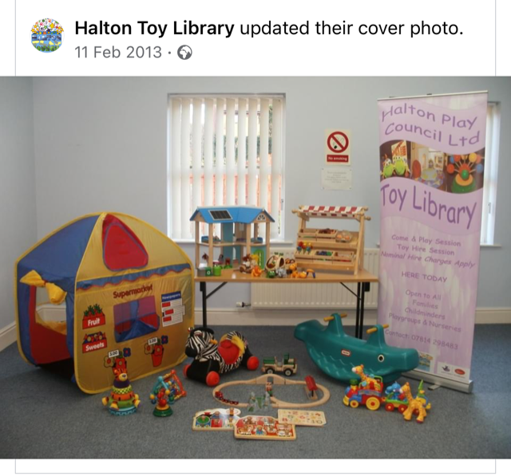

Notes:
Go onto Local Offer website here and show how to navigate.

Slide 4
In School support
Family Support Meetings
Share concerns or current issues being faced.
Refer to support services.
Provide information / advice.
Liaise with other professionals on your behalf
MAP (Multi Agency Planning) Meetings
‘Level 2’ support.
Refer to support services
Co-ordinate multi agency support.
Agree a plan and actions.
Review meetings every 8 -12 weeks.
Child In Need Meetings (CiN)
Similar to MAP meetings, but meetings led by a Social Worker.
Required for ‘Level 3’ support, including overnight short breaks.
Notes:
Transport = don’t have the opportunity to ‘pop’ into school to chat with staff. Meetings allow for adequate time to be given to your questions / concerns. Review meetings mean you are guaranteed updates on actions agreed – without you having to follow it up.

Slide 5

Types of support available:
Notes:
Most common themes of support requests are sleep, behaviour, communication, diet, respite, emotional support for parents & children.

Slide 6
Louise’s work phone - 07825 088621
Email: louise.green@brookfields.halton.sch.uk
School number: 0151 424 4329

