Slide 1
PSHE and Citizenship
Living in the Wider World | Money Matters
PSHE and Citizenship | KS1 | Living in the Wider World | Money Matters | Want or Need? | Lesson 5

Slide 3
Aim
I can explain the difference between things we want and things we need.
Success Criteria
I understand the difference between things we want and things we need.
I can explain why it important to understand the difference between what we want and what we need.
This resource is fully in line with the Learning Outcomes and Core Themes outlined in the PSHE Association’s Programme of Study.

Slide 4
The Big Questions

Slide 5
What is the difference between things we want and things we need?
Why is it important to understand this?

Slide 6
Reconnecting

Slide 7
What Choices Do We Have About What We Spend?
When I walked home from school today, I felt cold. I need a new coat for the winter.
When I went to play at my friend’s house, they had a really cool toy car. I need one like that to play with too!
Do you think both these things are ‘needed’? What is the difference between what we want and what we need?

Slide 8
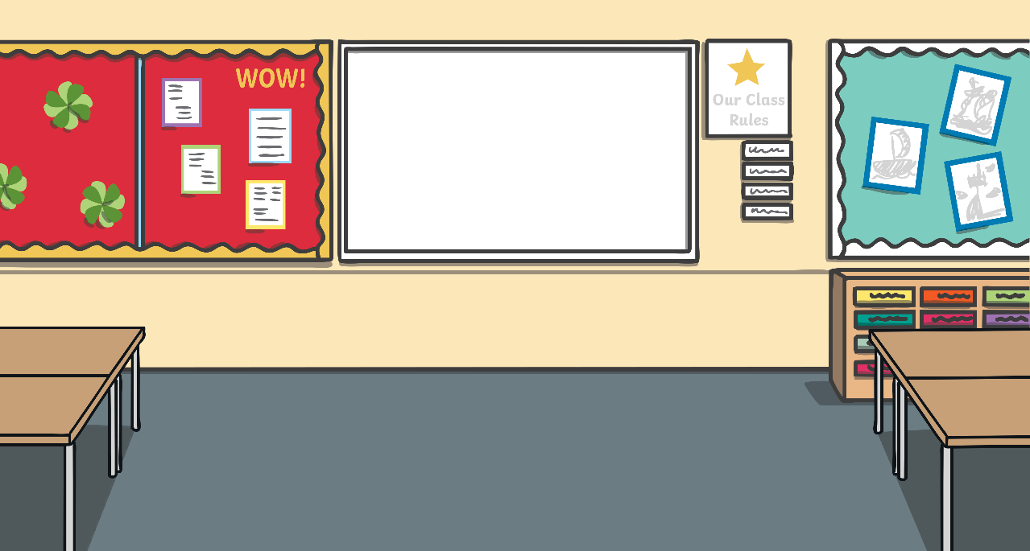
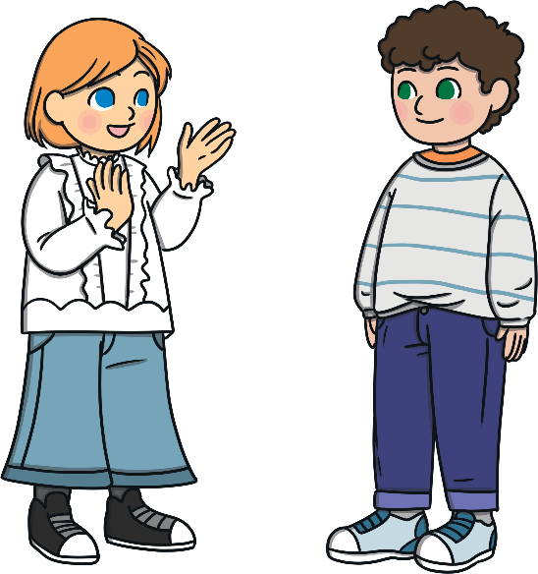
What Choices Do We Have About What We Spend?
Watch the following role play. What do you think the parent should do?

Slide 9
Exploring

Slide 10
Sort It Out!
You are now going to work in small groups to sort items into two groups - those we ‘want’ and those we ‘need’. They can be sorted however you choose, but try to make sure everyone in your group agrees with where each item is put.
want
need

Slide 11
How Did You Decide?
We are now going to see how other groups decided to sort their items. Walk slowly around the classroom and look at the way other groups have completed their task.
Is it similar to your sorting? Why do you think this is?
Consolidating
Reflecting

Slide 12
Consolidating

Slide 13
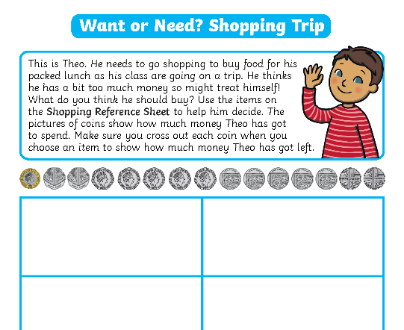
What Would You Buy?
We will now complete a shopping trip, working to a budget. Using the coins on your sheet can you help Theo go shopping?
This is Theo. He needs to go shopping to buy food for his packed lunch, as his class are going on a trip. He thinks he has a bit too much money, so he might treat himself too! What do you think he should buy?
Draw your answers on your Want or Need? Shopping Trip Activity Sheet and cross out the coins you spend as you go along.
Word Bank
money
necessity
spend
want
necessary
need
budget
important
treat
possessions

Slide 14
Reflecting

Slide 15
Want or Need?
What choices do we have when we spend money?
What do we actually need and what do we want?
Talking to the person next to you, can you finish
this sentence?
The difference between things I want and things I need is….

Slide 16
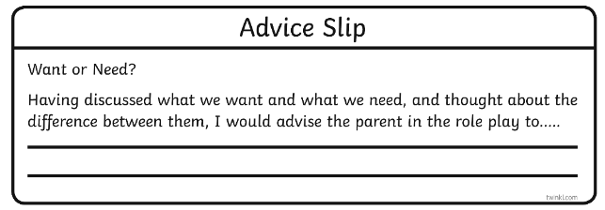
Want or Need?
Now think back to the role play we saw at the start of the lesson. Using what we have discussed today, what advice would you give to the parent now?
Talk about it with your partner and then write an Advice Slip to be posted into the Advice Box. We will be sharing them with the class.

Slide 17
The Big Questions

Slide 18
What is the difference between things we want and things we need?
Why is it important to understand this?

Slide 19
Aim
I can explain the difference between things we want and things we need.
Success Criteria
I understand the difference between things we want and things we need.
I can explain why it important to understand the difference between what we want and what we need.
This resource is fully in line with the Learning Outcomes and Core Themes outlined in the PSHE Association’s Programme of Study.

