Slide 1


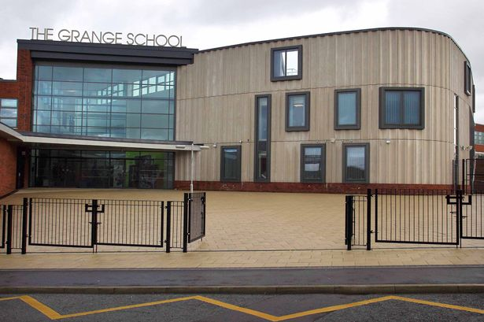
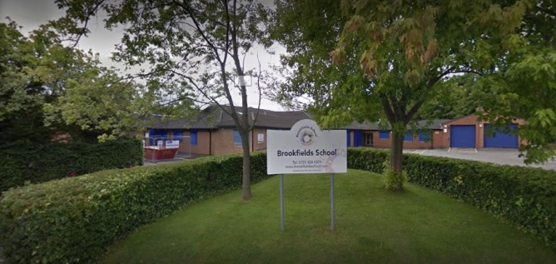

Welcome to Brookfields@ pupils

Slide 2
Hello 2021
Hello from Shelley for Foxes Parents
I have been privileged to visit all the new Foxes class intake within their nursery settings.
It has been fantastic getting to know your children and families via our phone conversations and visits to The Grange site.
I warmly welcome each and every one of you to Brookfields and am excited about starting your childs school journey with you.
If you have any worries, questions or require any further information please do not hesitate to call.
Please read through these slides to find out more about starting school.

Slide 3
Information
The school website is a first go to for information about school and the community. Here you will also find class information including photographs. www.brookfieldsschool.com
School day here starts at 9.00am-3.00pm.
You will be greeted at the main entrance of school each day and your children will be brought to class by a member of the class team.
We will email you daily about your child’s day. Please reply to let us know any useful information i.e. not slept well, not had breakfast or some lovely things you have been doing. This is a great way to communicate between home and school, especially for those who come on transport and don’t see the teaching team daily.
Please remember… we are always available for a chat on the phone if needed. This includes Louise Green our Family Support Worker, on the website is additional information with you regarding her role. Louise will contact all new parents within the first half term of them settling into school to introduce herself and talk though available services from Brookfields.

Slide 4
What do I need to bring?
Bring nappies, wipes and barrier cream (if applicable). Full packs can be stored in school. You will get a message from school when we need more.
Spare clothes to be kept at school. We will get wet and mucky! Please ensure names are in everything even shoes, coats, bags, hats and scarfs. EVERYTHING!
For rainy weather / seasons please provide wellies and waterproofs to be kept in school.
For a school bag use a ruck sack rather than book bag, this holds everything and also promotes independence as the children can carry them.

Slide 5

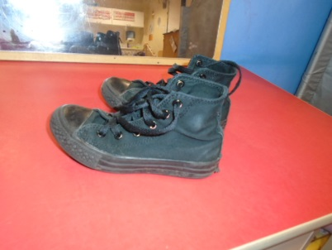
Uniform
Red jumper or cardigan (does not need to have a logo, this is your choice).
White shirt/polo shirt [we recommend polo shirt for easier dressing].
Grey skirt / dress or trousers/shorts
Red and white checked school summer dress
For children in continence products [nappies] and those who are in the early stages of toilet training, we find jogging bottoms or girls leggings are easier for dressing and promoting independence.
If your child regularly takes off their shoes please consider high top
shoes/boots.
Jumpers and polo shirts can be ordered from via the school website [see Uniform tab] (with logo) or you can buy plain ones from supermarkets.
We will get messy!! We do have aprons in class but if your child does not like these for sensory needs then please provide an old top / or wear one that can get mucky.

Slide 6

Swimming: towel swim nappy if applicable trunks/costume
The class team will let you know when swimming will commence, this will not be within the first term.
When the weather is nice we sometimes wear swimwear in class and play in the paddling pool – you will be informed when to send in clothing for this activity.
Pe: No additional clothing required, we will practice taking our jumpers or cardigans off.
Swimming and PE

Slide 7

Medical Information
If your child is absent with sickness please contact Brookfields School main office and a message will be communicated with Shelley [Foxes] or Stacey [Bumblebees]. 0151 424 4329
You can also call the office at The Grange switchboard and ask for Shelley or Stacey at Brookfields@. 01928 562660 or dial Extension 182
If your child comes on the bus/taxi you must call school and not pass a message on with the guide. You must also inform transport yourselves of pupil absence this includes occasions if your child may be sent home from school during the day to cancel evening transport..
We cannot give any other medication in school unless it has been prescribed with a medical label with your child's name on. We can only give prescribed medication i.e. antibiotics if it is to be taken 4x per day.
For any medicine administration a medical form must be completed - this is available on the school website.
Please communicate with school any additional medical needs your child has i.e. are they under physiotherapy care, continence services, have an occupational therapy or speech and language therapy care plan. It is important that the strategies used at home and school are consistent.

Slide 8

Lunch and Snack
All pupils will be provided with a school meal.
I would suggest bringing a packed lunch initially so that the children have food they like that is familiar from home. This will be presented after they are encouraged to eat a school supplied meal.
We will place it near to them and encourage them to try new foods.
Snack is £2.00 per week (pay per term - Payments to be made electronic via SCHOOL GATEWAY - No cash please)
Please see the leaflet in your welcome pack on how to do this.
Any problems please contact Brookfields school office and speak to Lyndsey, our finance manager.

Slide 9

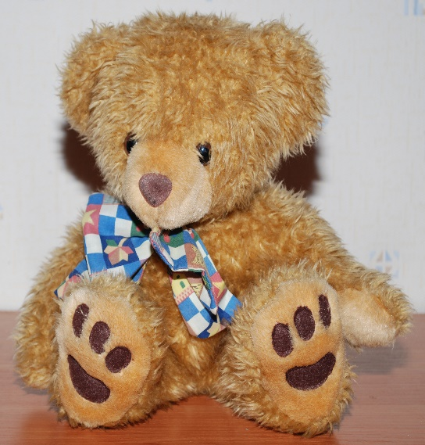
Toys from home.
We understand some children may require some toys/items as a comforter.
If possible try to discourage their favourite toys being brought to school as it can be difficult for the teaching teams to ensure they go home or are not played with by other children.
If they do bring a toy please ensure it has their name on it.

Slide 10
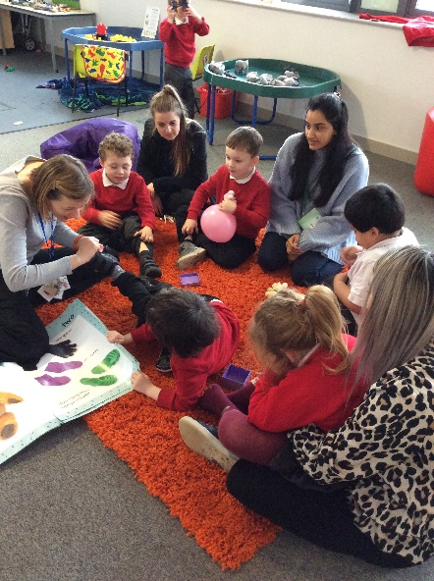
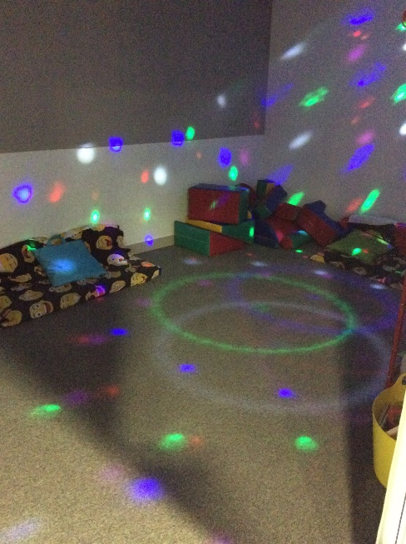
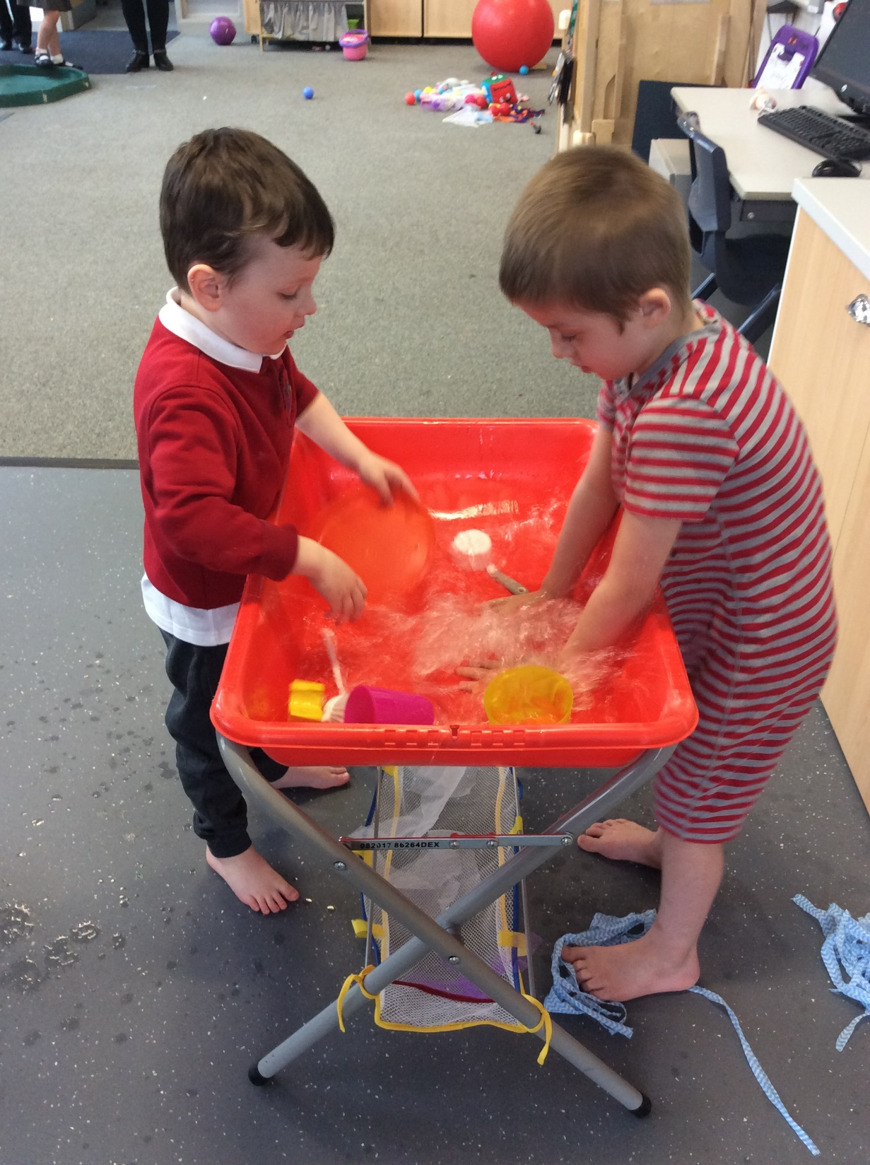
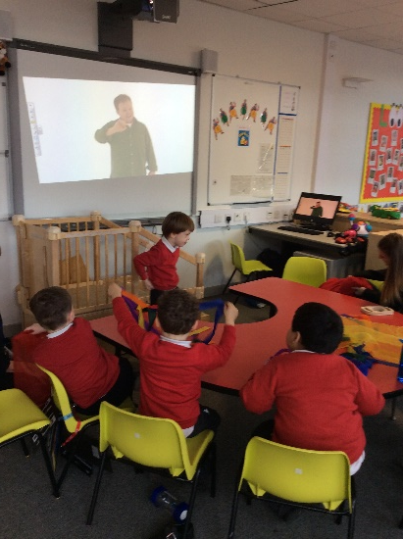
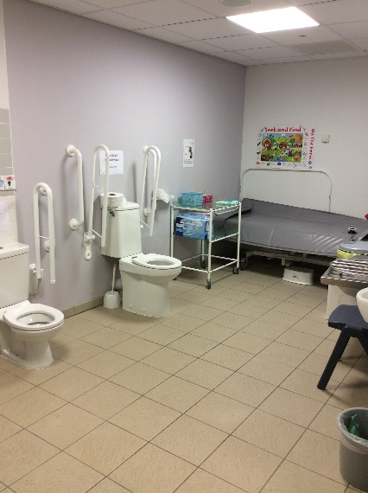
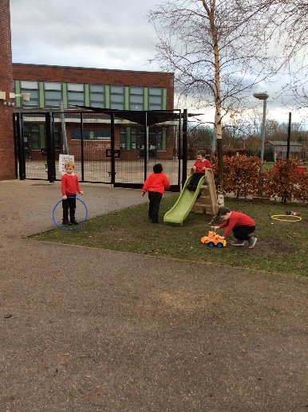
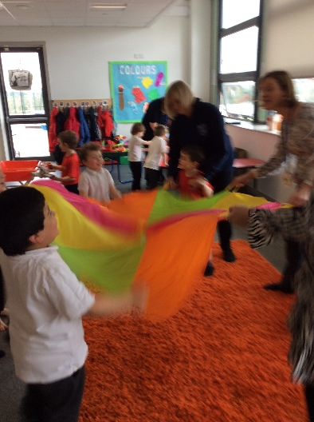
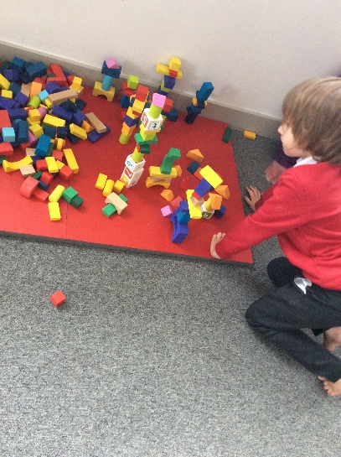
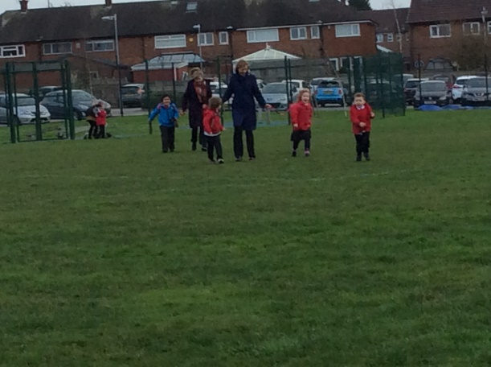
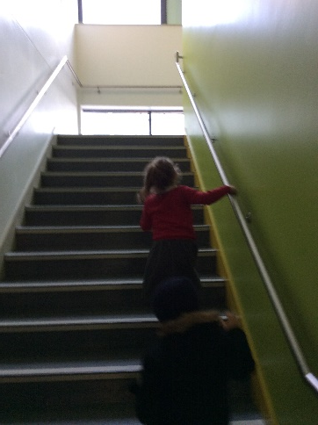
What happens during the school day?

Slide 11

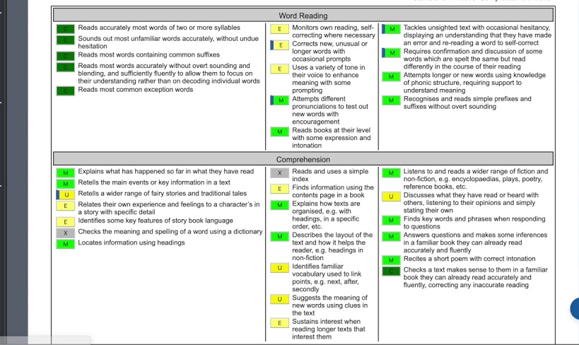
Early Years Curriculum
We follow the Development Matters in the Early Years Foundation Stage (EYFS) curriculum – there is a new Curriculum documentation from September 2021 .
We use an assessment tool called B-Squared to look at can do achievements for your child. This tool is extremely detailed and may give a slightly different level than what your child has achieved at nursery or their pre school setting. This simply means their achievements are being monitored in a different way and is a process they will continue through school.

Slide 12
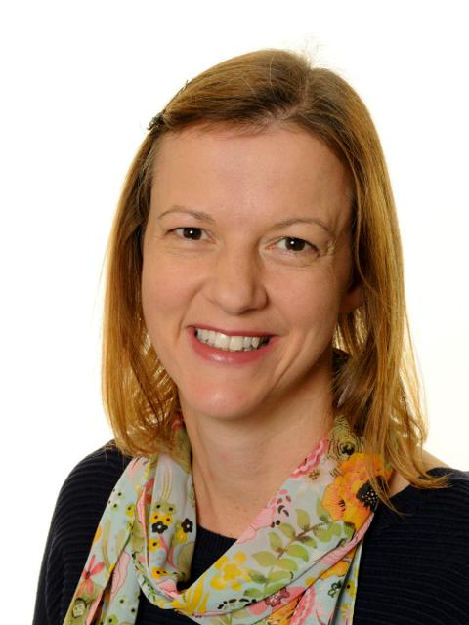
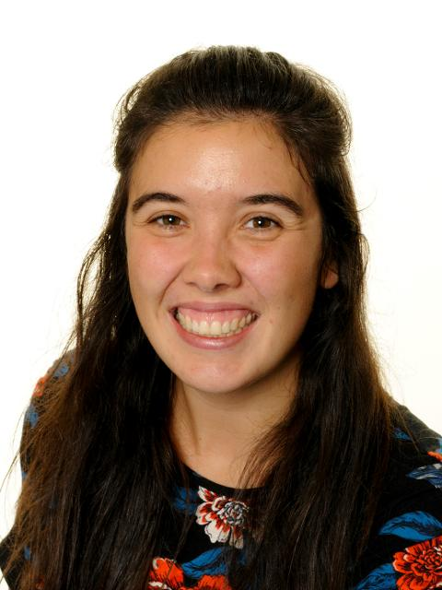


Teaching Team
Stacey and Shelley are each supported by 3 members of staff within our teams. We will individually share with you whom these staff are.
Vicky is our HLTA who covers our classes for planning time and she will be a link person for contacting you via email on these days.
Shelley O’Connor
Stacey
Clark

Slide 13
Paperwork and next steps
The class teacher will check your admissions paperwork and contact you with any further questions we have.
We will take time to get to know your child and their family, currently through telephone conversations.
You can ask the teaching team any questions you have.
Please use the school website for information and support www.brookfieldsschool.com.
Please follow us on Facebook and Twitter for further communication from school.
You will hear from Shelley [Foxes new starters] around start times form Septembers transition.

