Slide 1
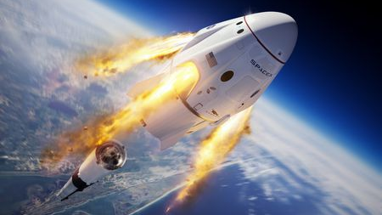
SpaceX launch!!!
https://www.bbc.co.uk/news/science-environment-52855029

Slide 2
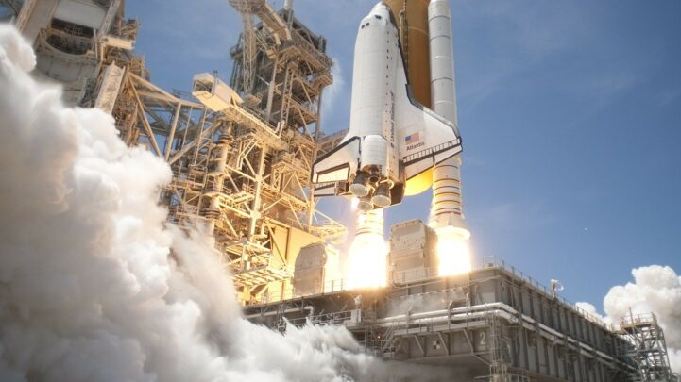
What is SpaceX?
SpaceX is a space company that is in America
SpaceX was the first private company to routinely return rocket stages to Earth
Now they have astronauts on board!
Watch the space rocket song!
https://www.youtube.com/watch?v=SAHy_2IFFGA

Slide 3
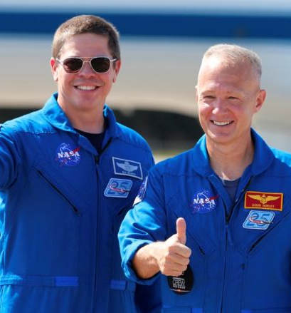
Who are the astronauts?
Doug Hurley and Bob Behnken
They are the first astronauts to launch from America since the retirement of the space shuttle in 2011.
https://www.bbc.co.uk/news/science-environment-52739539

Slide 4
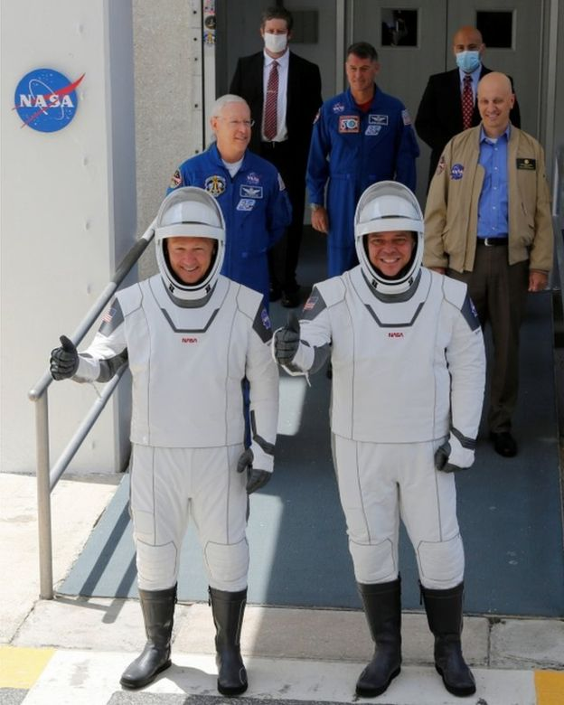
Here they’re at NASA
They will be in space for up to 4 months!
One of their first tasks in orbit was simply to name their ship - in the tradition of past US spacefarers, all the way back to the Mercury programme. Radioing down to Earth, they announced it would be called Endeavour.
Doug Hurley said: "We chose Endeavour for a few reasons: One, because of this incredible endeavour that Nasa, SpaceX and the US have been on since the end of the shuttle programme back in 2011. The other reason is a little more personal to Bob and I. We both had our first flights on shuttle Endeavour and it just meant so much to us to carry on that name."

Slide 5
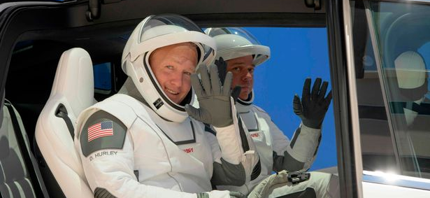
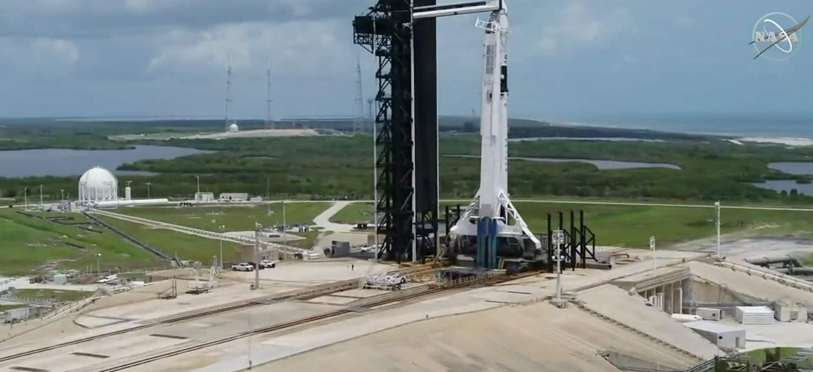
Where will Endeavour go?
They are travelling to the International Space station
It will roughly take 110 days to get there!
Watch it launch!
https://www.youtube.com/watch?v=W36QKRS_t5k

Slide 6
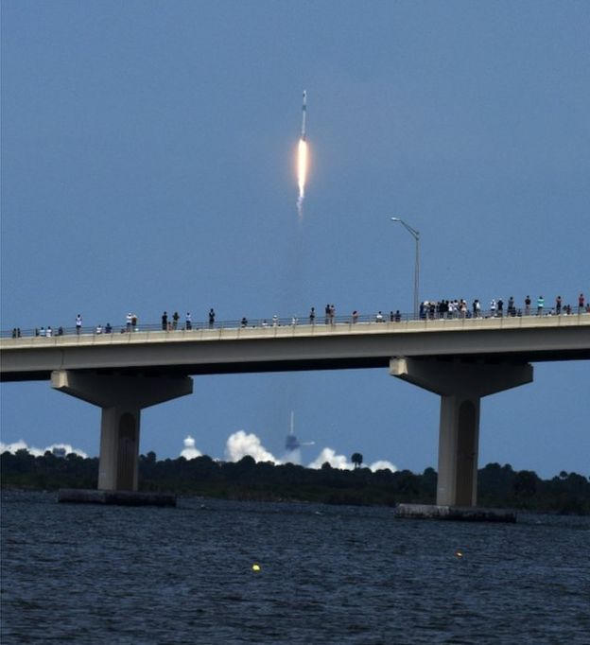
The Hawks jobs
Design your own rocket
Write a newspaper report about the SpaceX launch
Write a letter to Doug Hurley and Bob Behnken.

Slide 7
What do you need to make your own rocket?
You could use a plastic water bottle, card, glitter and don’t forget to draw a window!
What planets will you see on your travels?
Don’t forget to name your rocket!
https://recipes.sainsburys.co.uk/articles/fun-stuff/transform-a-bottle-into-a-rocket-in-6-easy-steps

