Slide 3
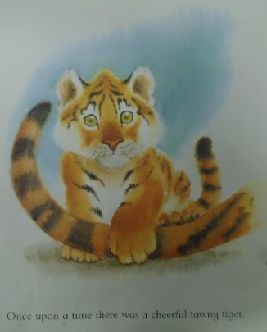
Once upon a time there was a cheerful tawny tiger.

Slide 4
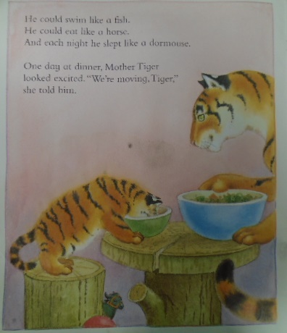
He could swim like a fish.
He could ear like a horse.
And each night he slept like a dormouse.
One day at dinner, Mother Tiger looked excited “We’re moving, tiger,” she told him.

Slide 5
Then she took Tiger outside and pointed across the lake. “I’ve found a new house for us and tomorrow we must pack up our things.”

Slide 6
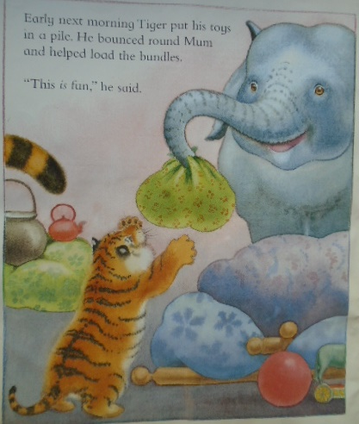
Early next morning Tiger put his toys in a pile. He bounced round Mum and helped load the bundles.
“This is fun,” he said.

Slide 7
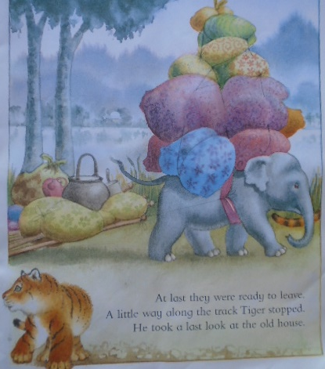
At last they were ready to leave.
A little way along the track Tiger stopped.
He took a last long look at the old house.

Slide 8
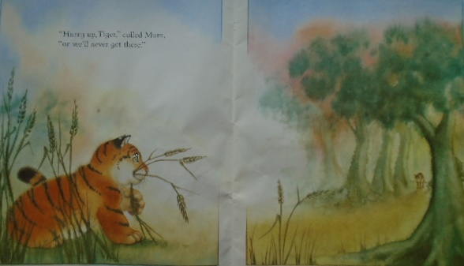
“Hurry up, Tiger,” called mum,
“or we’ll never get there.”

Slide 9
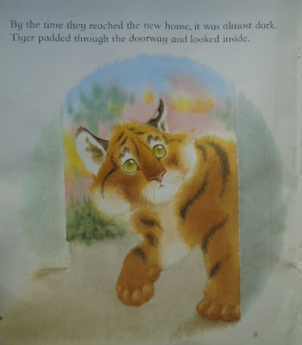
By the time they reached the new house, it was almost dark. Tiger padded through the doorway and looked inside.

Slide 10
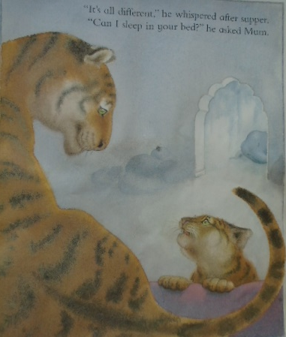
“It’s all different,” he whispered after supper. “Can I sleep in your bed?” he asked mum.

Slide 11
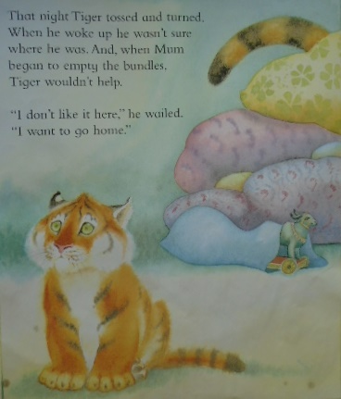
That night Tiger tossed and Turned.
When he woke up he wasn’t sure where he was. And, when Mum began to empty the bundles Tiger wouldn’t help.”
“I don’t like it here.”
he wailed.
“I want to go home.”

Slide 12
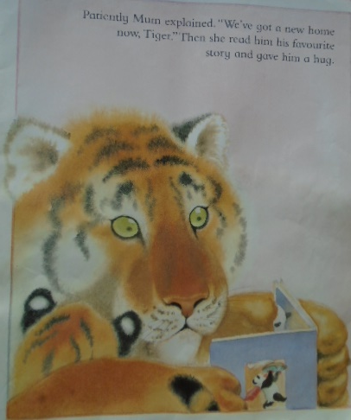
Patiently Mum explained .”We’ve got a new home now, Tiger” Then she read him his favourite story and gave him a hug.

Slide 13
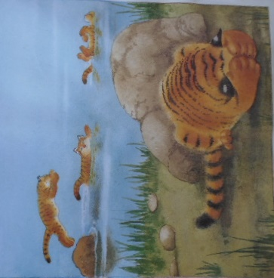
But Tiger still felt grumpy. He refused to swim in the lake with the other tigers. He began to play with his food instead of eating it.

Slide 14
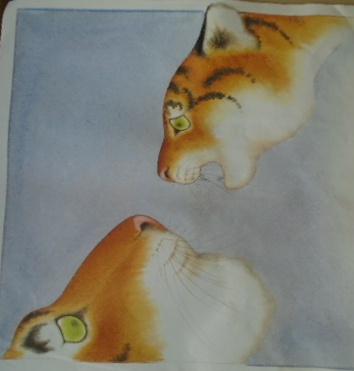
And night after night he woke Mum.
“I want to go home.” he kept telling her.

Slide 15
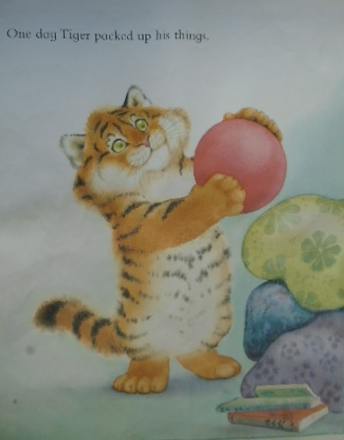
One day Tiger packed up his things.

Slide 16
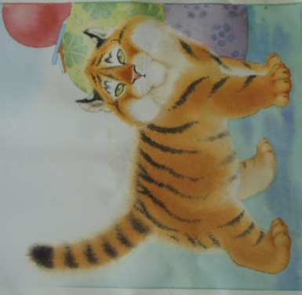
“I’m going home now.” he announced.
“This is our home.” explained mum.

Slide 17
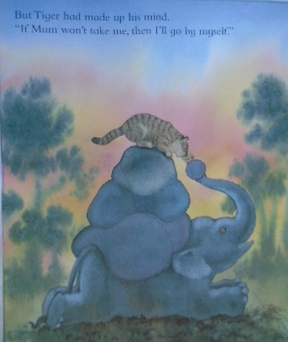
But Tiger had made up his mind.
“If Mum won’t take me, then I’ll go by myself.”

Slide 18
As soon as the moon came up. Tiger set off.

Slide 19
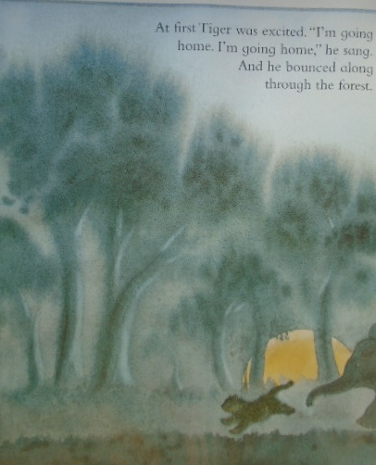
At first Tiger was excited. “I’m going home. I’m going home,” he sang. And he bounced along through the forest.

Slide 20
But, when he reached their old house, the moon disappeared.
Tiger began to feel unsure.
He looked nervously over his shoulder.

Slide 21
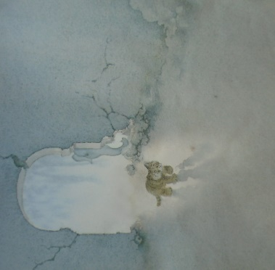
Then he padded inside.
“I’m home, I’m home,” he whispered into the empty house.

Slide 22
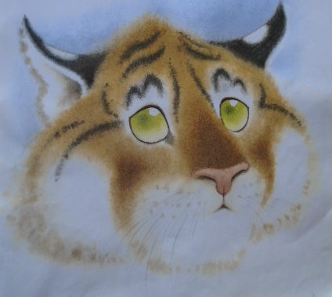
But, home didn’t feel right. There was no sound of Mum humming or snoring. There was no smell of her warm fur or a tasty meal.
There was no one to give him a hug or a story.

Slide 23
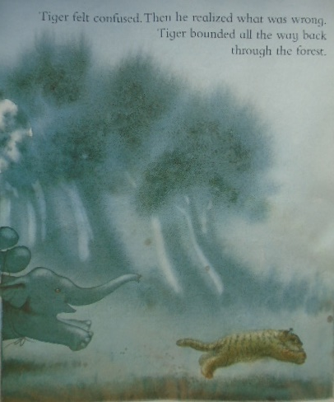
Tiger felt confused. Then he realised what was wrong. Tiger bounded all the way back through the forest.

Slide 24
Mother Tiger woke with a start.
“Whatever is it?” she asked.
“I want my home!” cried tiger. “I want my home!”

Slide 25
Mum sat up and yawned
“This is our new home...” she began.
But Tiger wouldn't let her finish.

Slide 26
“I know that now!” he cried. Then he tried to explain.
“There’s no home left in our old house.” said Tiger.
“Because it’s all moved here!”

Slide 27
Next morning a cheerful tawny tiger went out to play.
He splashed in the lake with his new friends.
“Come to dinner at my house.” he told them.

Slide 28
That night Tiger bounced on his bed at bedtime.
“It’s time to tuck me in,” he shouted to mum.

Slide 29
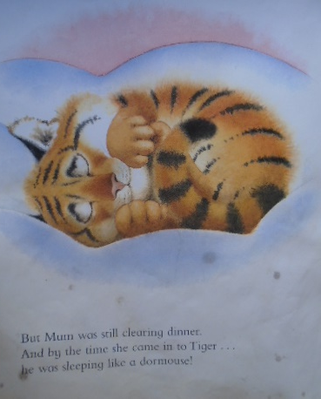
But Mum was still clearing dinner,
And by the time she came in to tiger…
he was sleeping like a dormouse.

Slide 30
