Slide 2
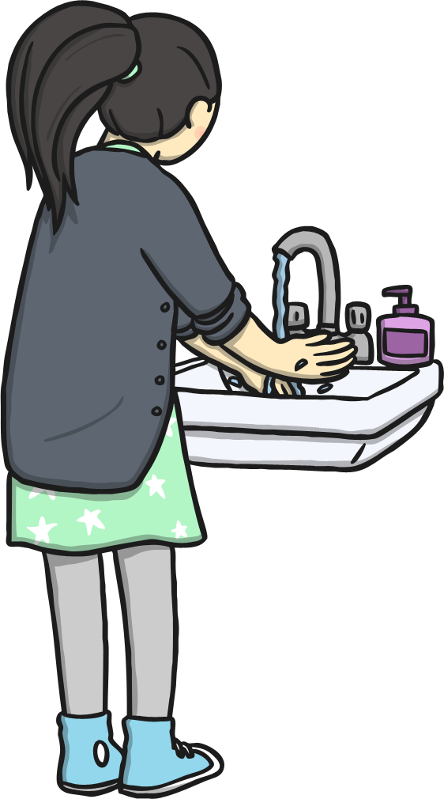
This is the way we wash our hands,
Wash our hands, wash our hands.
This is the way we wash our hands,
With lots of soap and water!

Slide 3
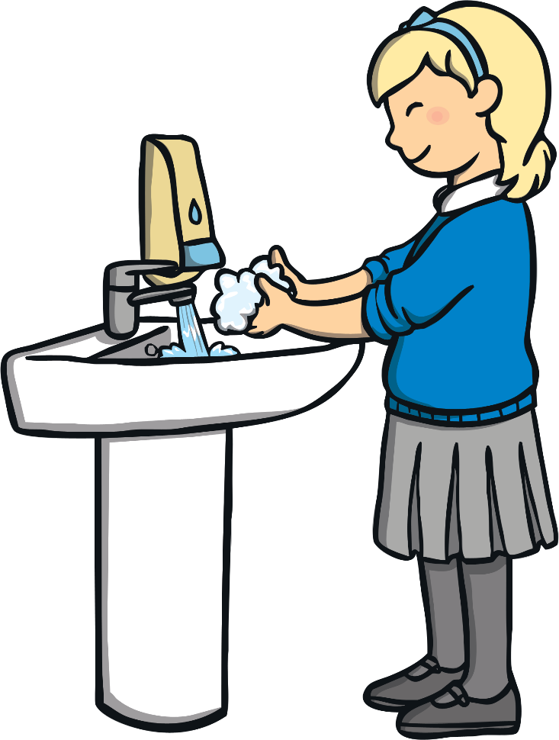
This is the way we use the sink,
Use the sink, use the sink.
This is the way we use the sink,
Get lots of nice warm water.

Slide 4
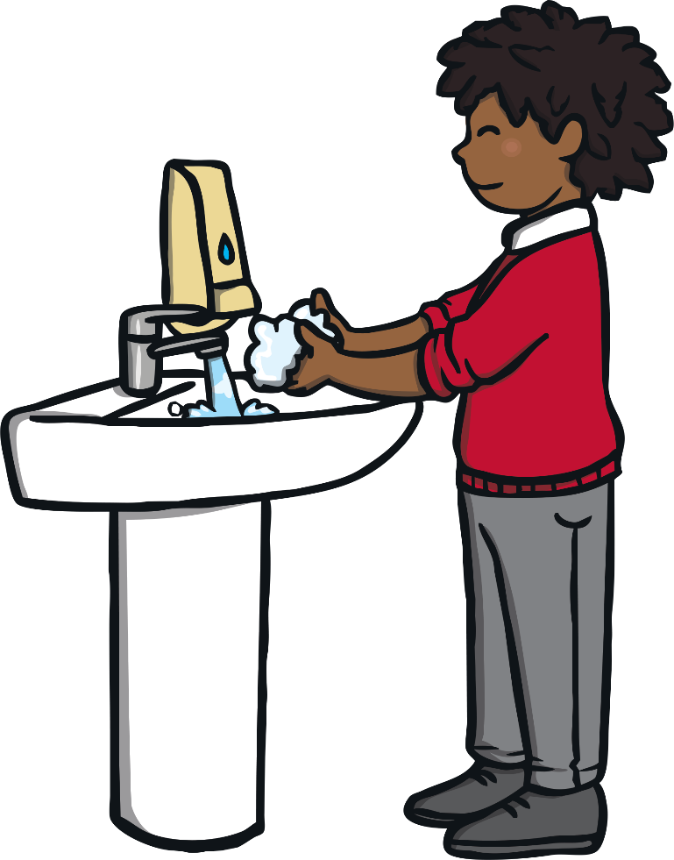
This is the way to use the soap,
Use the soap, use the soap.
This is the way to use the soap,
To make a bubbly mixture!

Slide 5
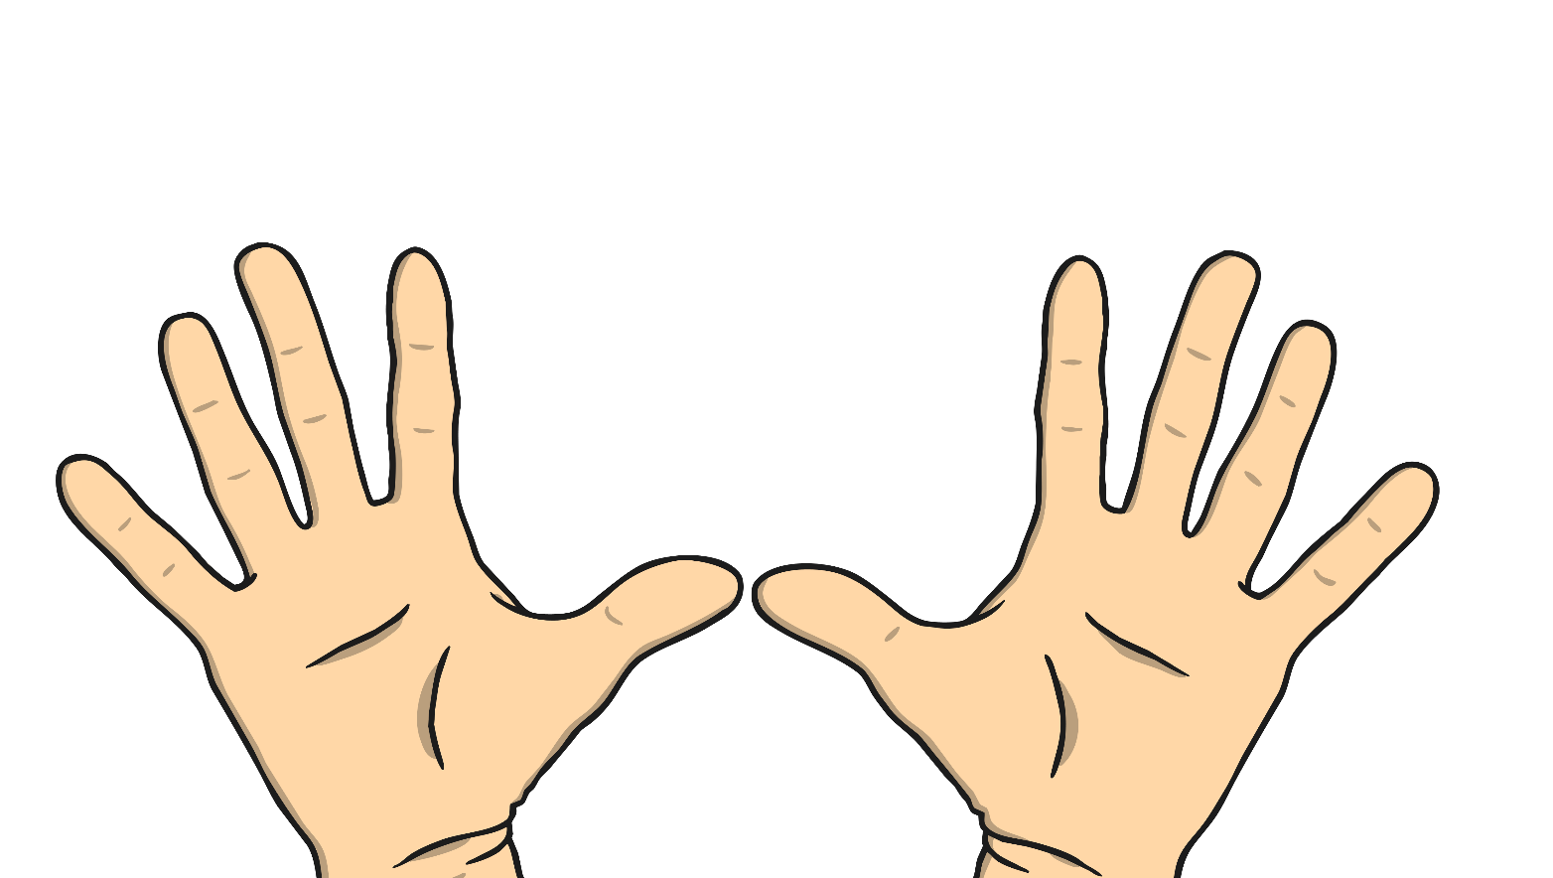
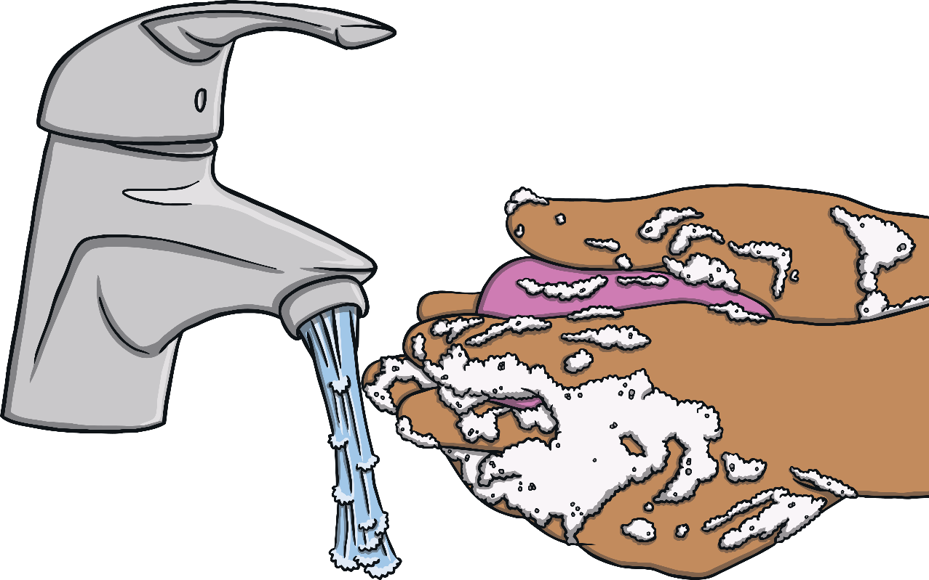
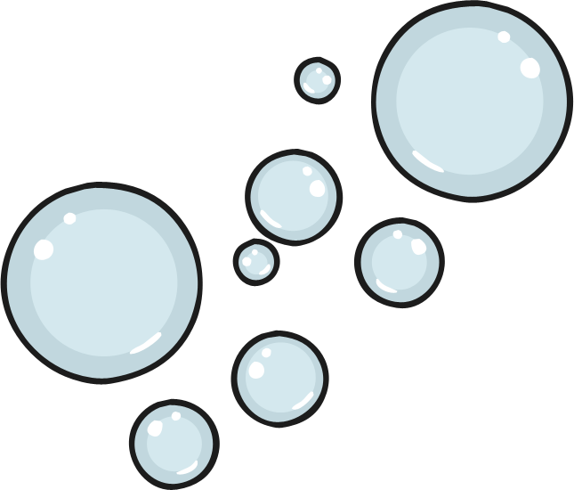
This is the way to rinse your hands,
Rinse your hands, rinse your hands.
This is the way to rinse your hands,
And wash away the bubbles.

Slide 6
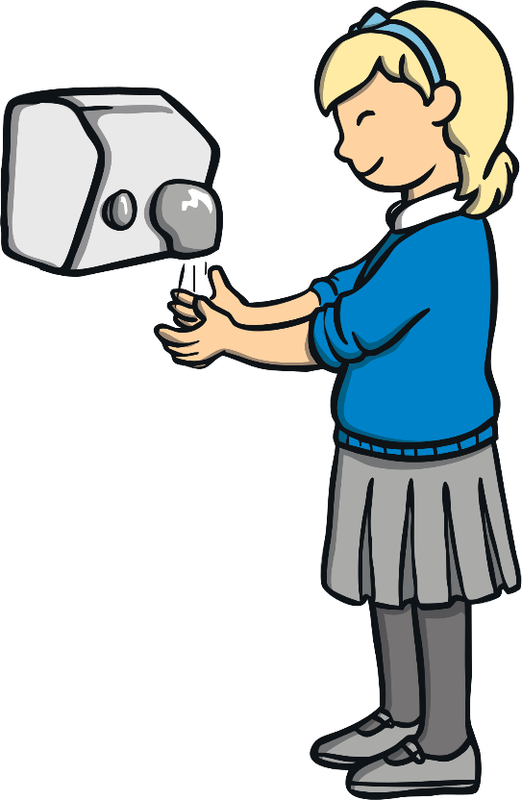
This is the way we dry our hands,
Dry our hands, dry our hands.
This is the way we dry our hands,
And now your hands are all clean!

Slide 7
That is the way we wash our hands,
Wash our hands, wash our hands.
That is the way we wash our hands,
With lots of soap and water.

