Slide 1
Welcome back to Brookfields School 08.03.21

Slide 4
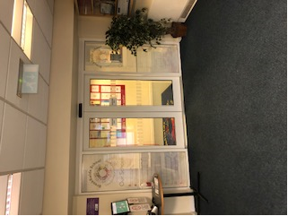

Slide 5
This is the corridor

Slide 6
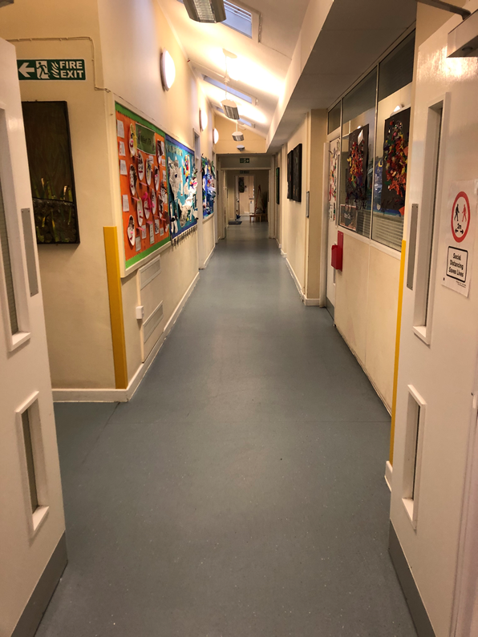

Slide 7
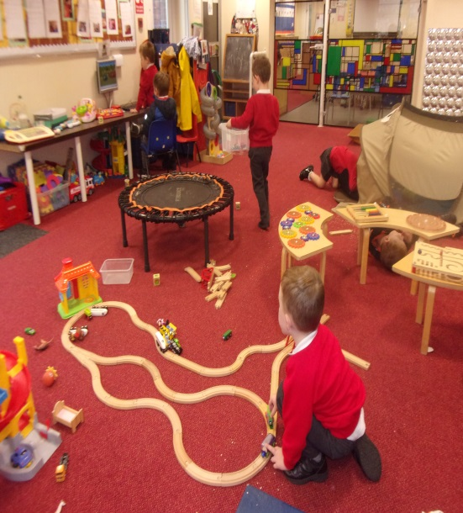
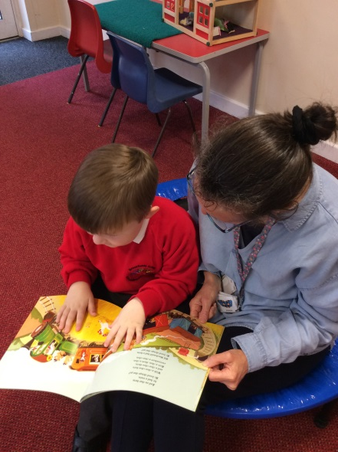
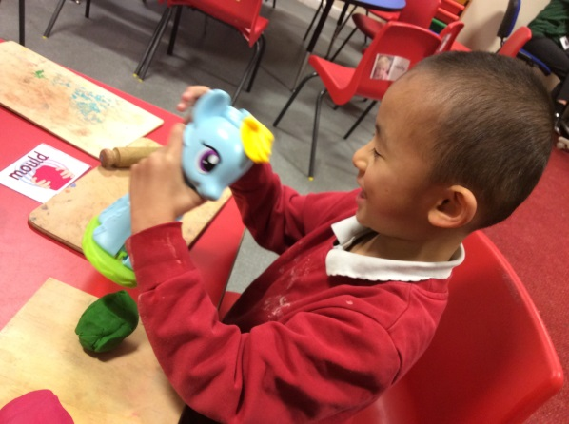
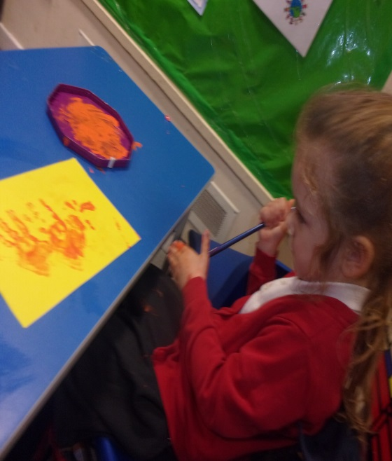

Slide 9
This is the hall

Slide 10
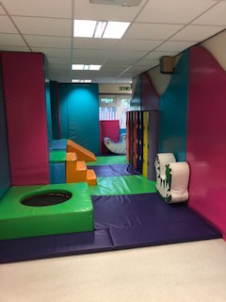
This is our soft play room
We like to bounce and jump!

Slide 11
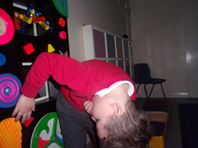
This is our light room
We like to watch the lights. We like to relax!

Slide 12
This is the ‘Tyre Park’
We like to swing!

Slide 13
We have lots of staff to help you

Slide 14
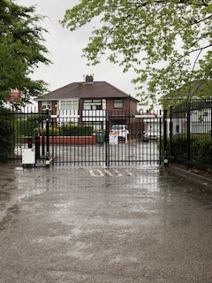
This is the way out.
This is the way we go home

Slide 15
We are looking forward to seeing you soon.

