Slide 1
Week 4 This week in school we are learning about how instructions; how to follow key information given verbally or in written form. To begin with we are learning how to wash our hands. A practical activity which can be support by using picture prompts. Throughout the week we will follow instructions when given less verbal prompts as well as make a go at writing our own for making a jam sandwich.

Slide 3
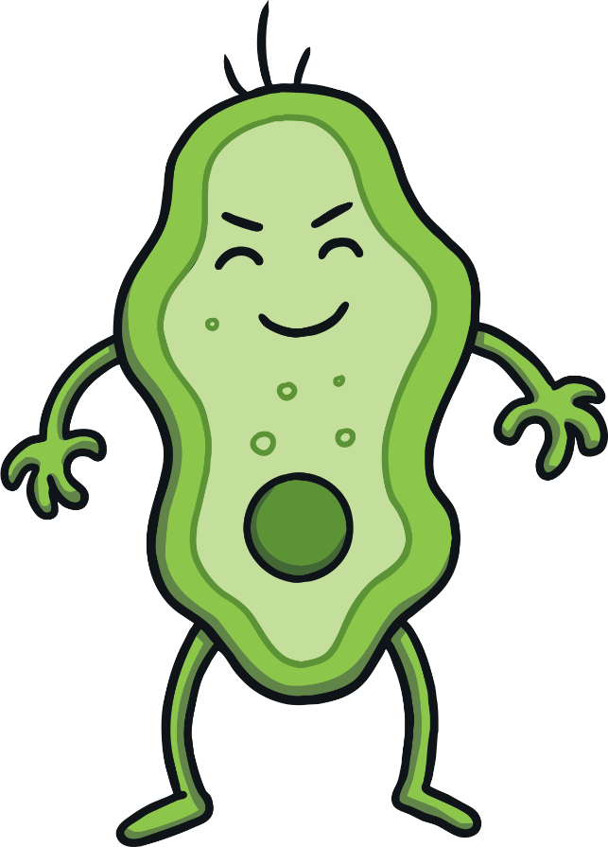
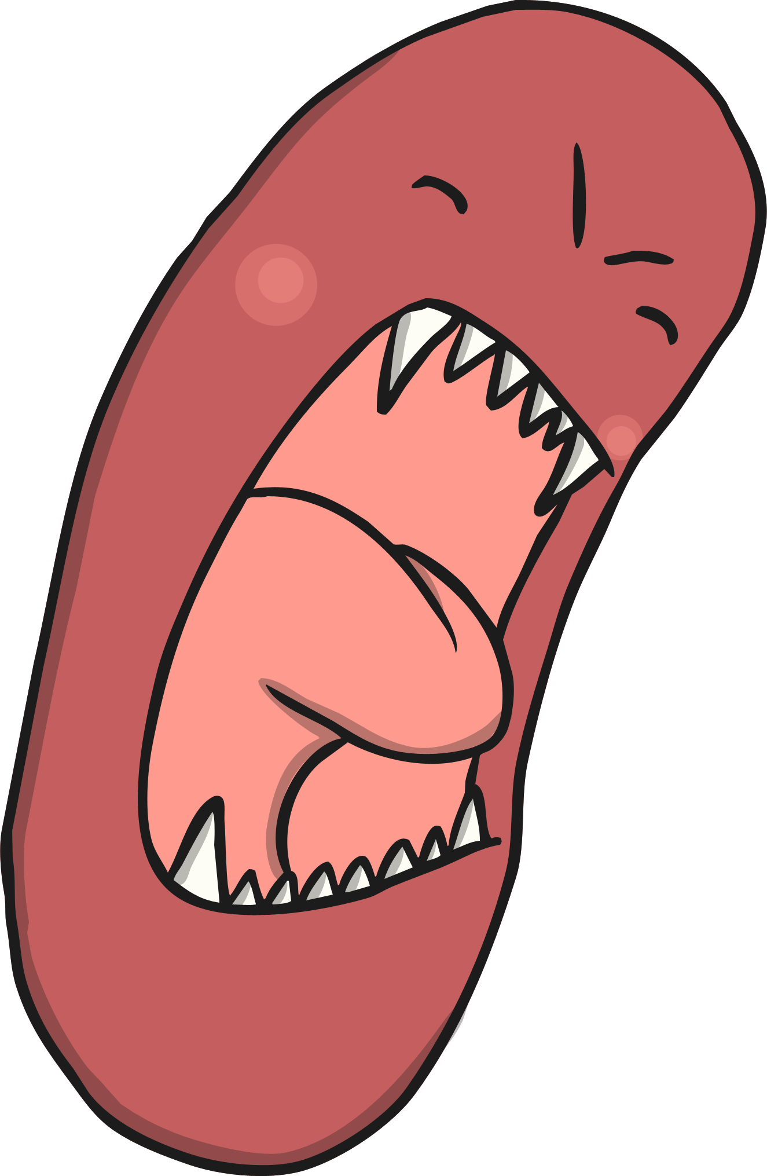
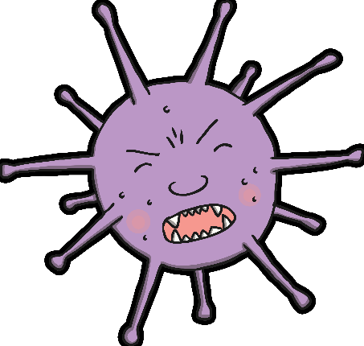
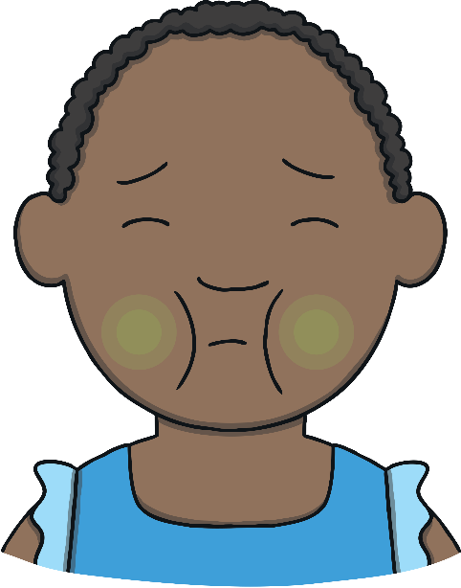
What Are Germs?
Washing your hands helps to remove germs. Germs are very, very tiny – they are so small we cannot see them.
Some germs can make us poorly. Washing our hands stops the germs from spreading or getting inside our bodies and making us feel ill.

Slide 4
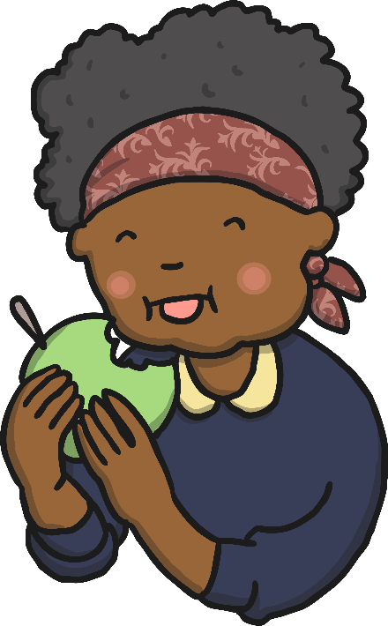
When Should You Wash Your Hands?
It is important to wash your hands…
before eating
before touching food (e.g. cooking activities)
after going to the toilet
after blowing your nose, sneezing or coughing
after touching your pets or other animals
after playing outside
after playing with messy toys (e.g. playdough)

Slide 5
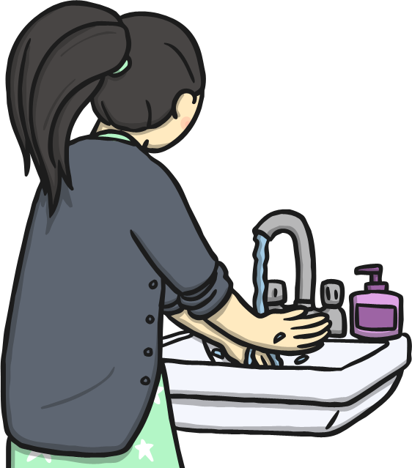
How to Wash Your Hands
First, turn on the tap and rinse your hands.

Slide 6
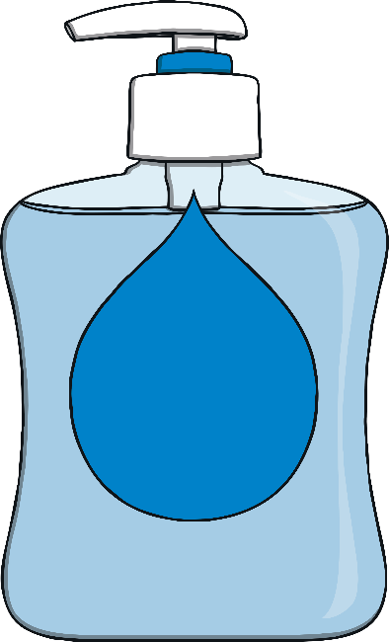
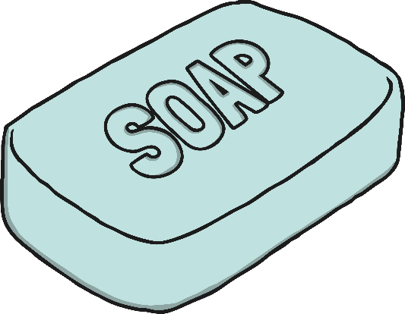
How to Wash Your Hands
Next, put some soap on your hands.
Sometimes you might use soap that comes out of a bottle and sometimes you might use a bar of soap.
Soap is very important for making your hands clean and getting rid of any germs.

Slide 7
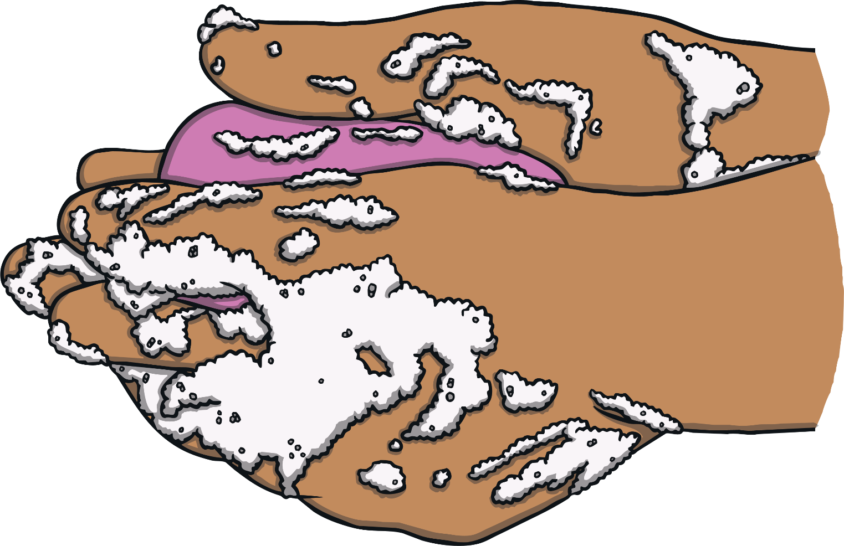
How to Wash Your Hands
Then, rub your hands together for 20 seconds to make lots of bubbles and foam!
Make sure that your hands and all of your fingers are soapy and bubbly!

Slide 8
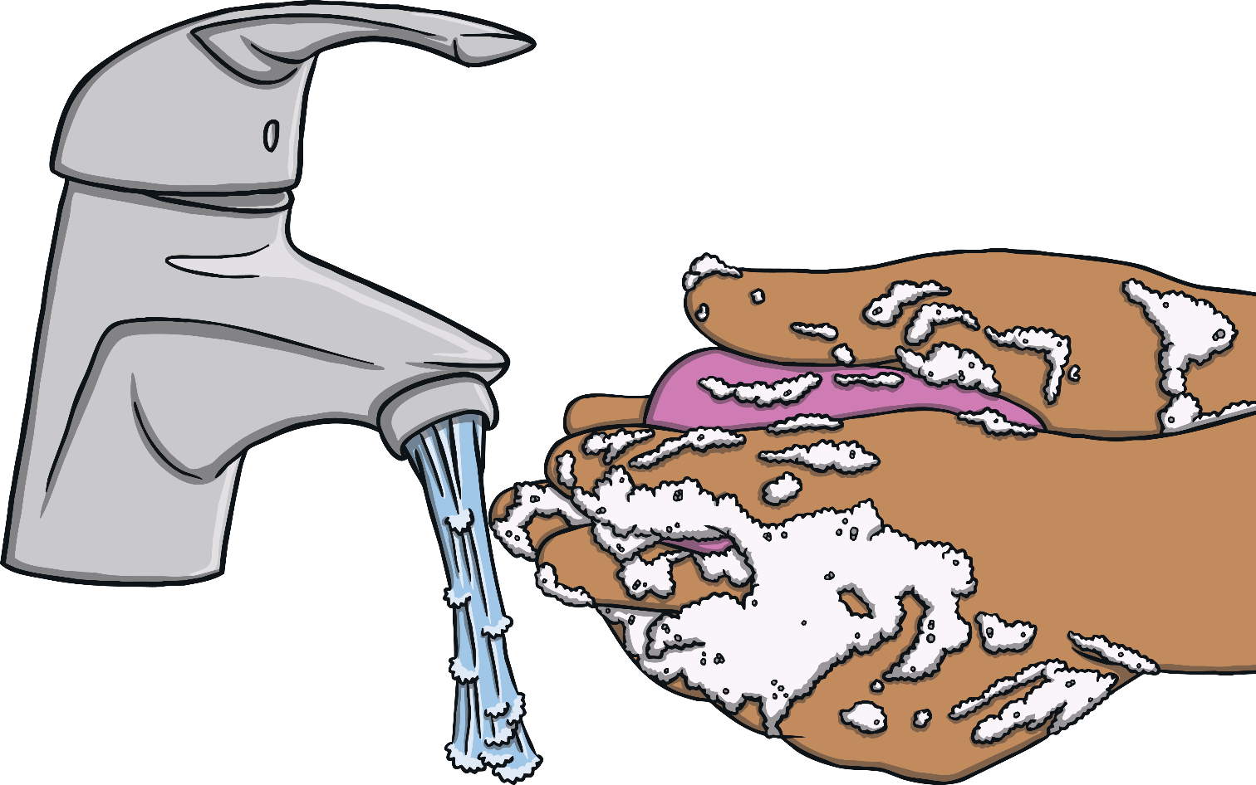
How to Wash Your Hands
Next, rinse your hands under the water again. Make sure to wash away all of the bubbles.

Slide 9
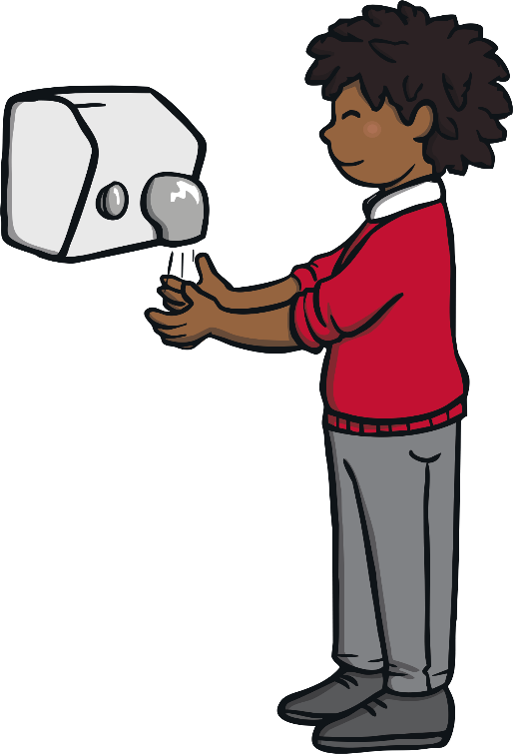
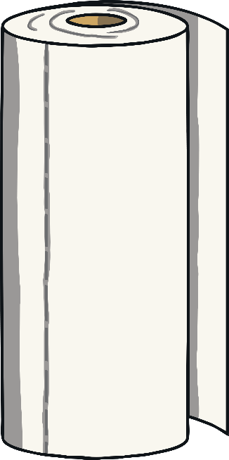
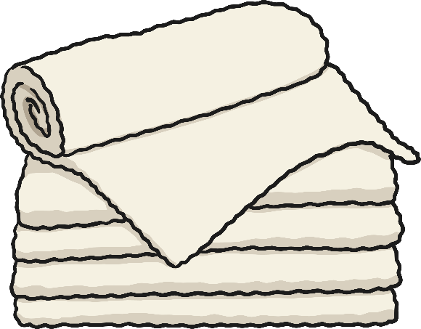
How to Wash Your Hands
The last thing to do is dry your hands. You could use a paper towel, a soft towel or a hand dryer.
If you use a paper towel, make sure you put it in the bin when you are finished!

Slide 10
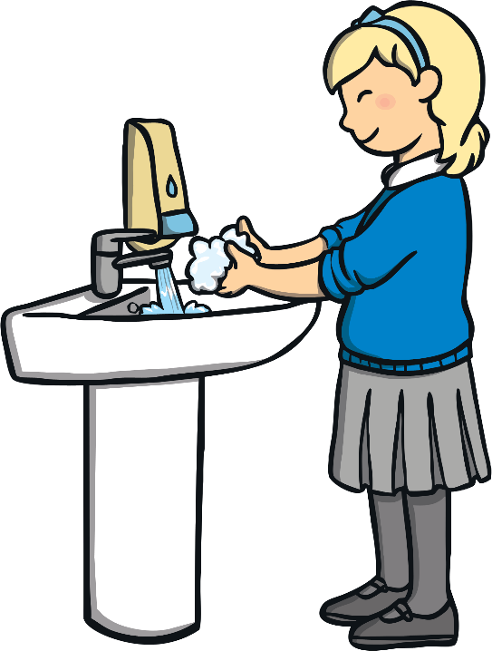
Tell a Friend
Can you remember when to wash your hands?
What do you need to do to make sure your hands are clean?
Tell a friend all you have learnt about washing your hands.

