Slide 2
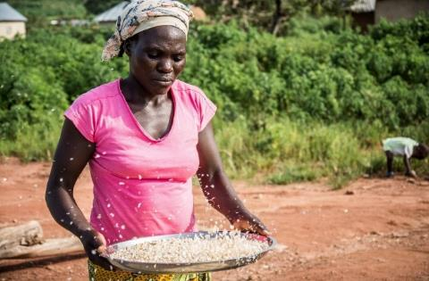
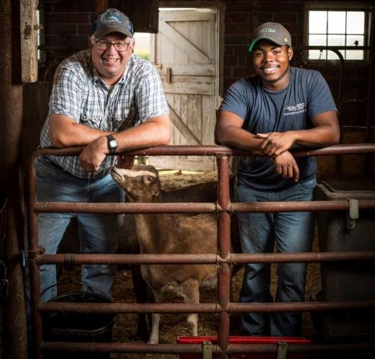
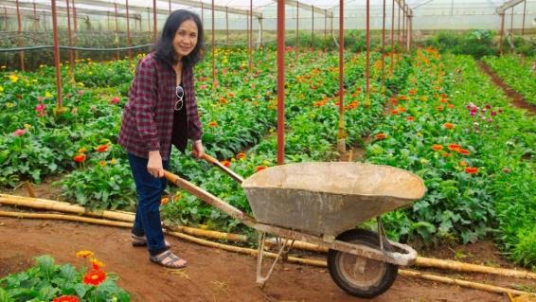
Jobs on the Farm
There are farms all over the world.
Farmers grow food for people to eat.

Slide 3
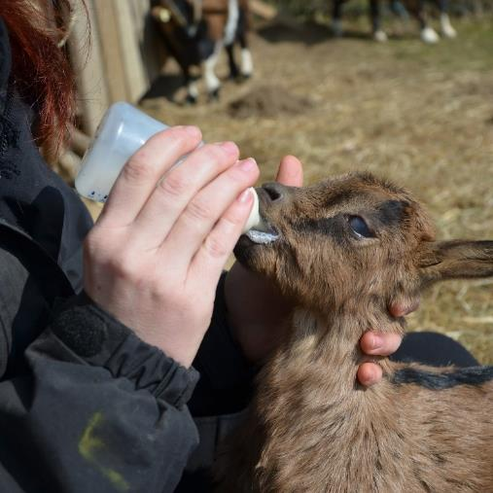
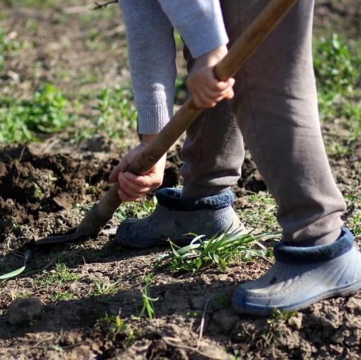
Jobs on the Farm
Some farms have animals, like cows, chickens, goats and sheep.
Some farms grow crops, like vegetables or wheat.
There are lots of jobs to do on any farm.

Slide 4
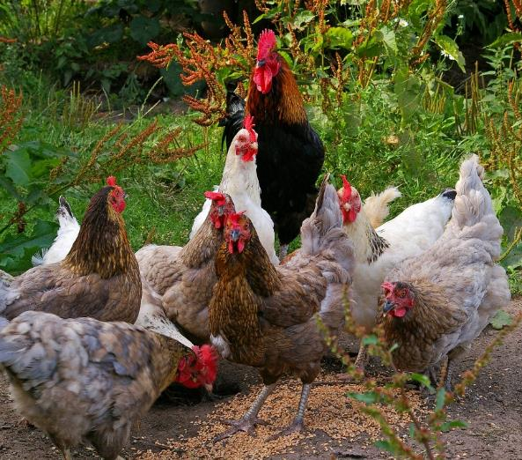
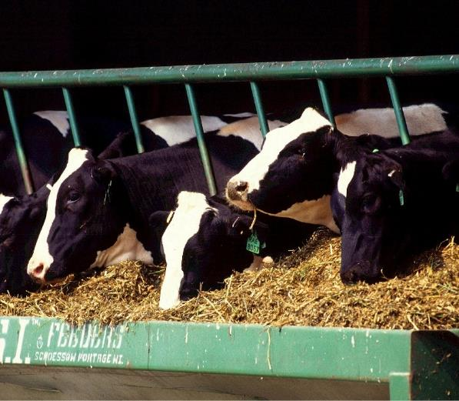
Feeding the Animals
The animals need to be fed every day.
Chickens are fed grain, seeds and corn.
Cows are fed hay, grain and soy. Some cows eat grass, too.

Slide 5
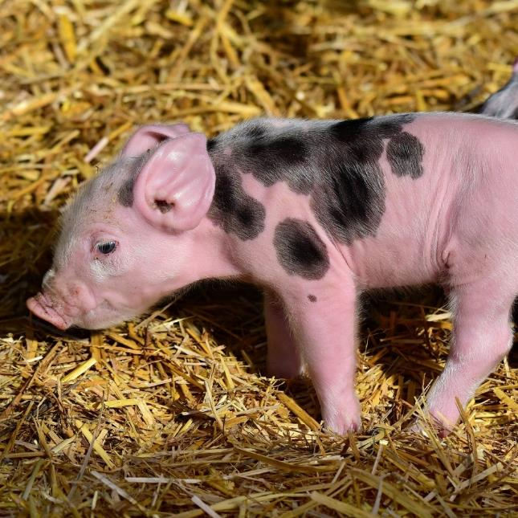
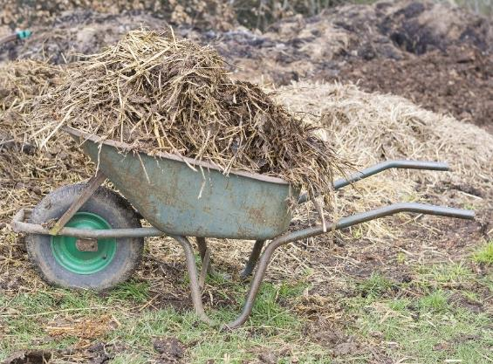
Keeping the Animals Clean
The animals’ stables and pens must be kept clean.
Dirty straw is removed. Fresh straw keeps the animals warm and dry.

Slide 6
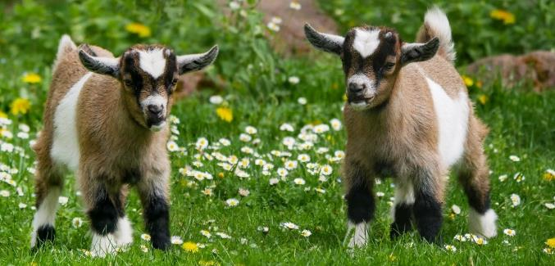
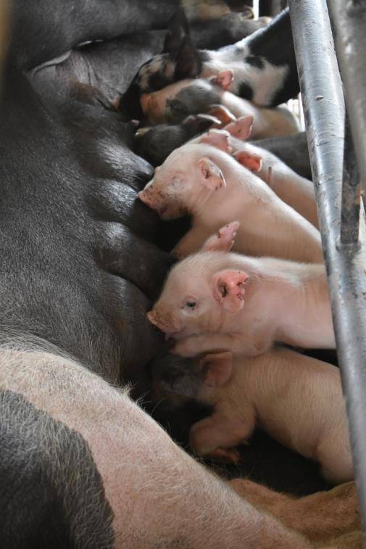
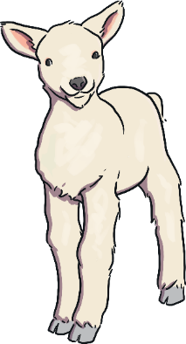
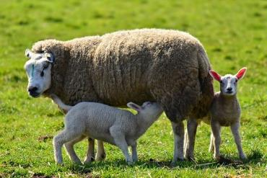
Looking After the Babies
Lots of baby animals are born on farms each year.

Slide 7
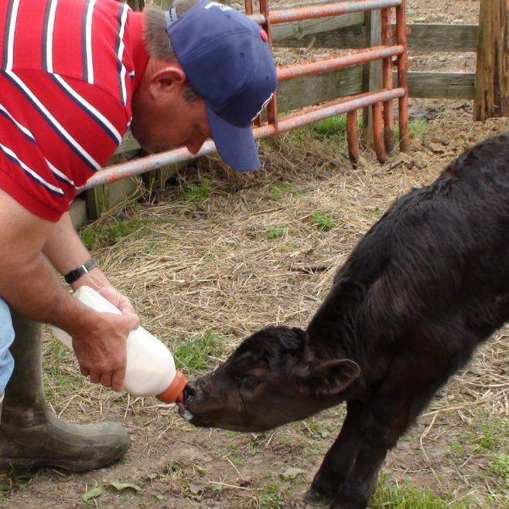
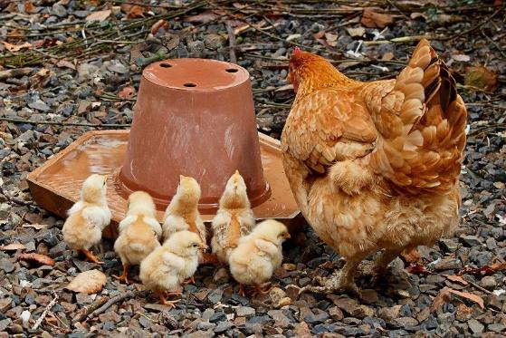
Looking After the Babies
The farmers look after the baby animals to keep them healthy and make sure they grow.
It is important that they have enough food and water.

Slide 8
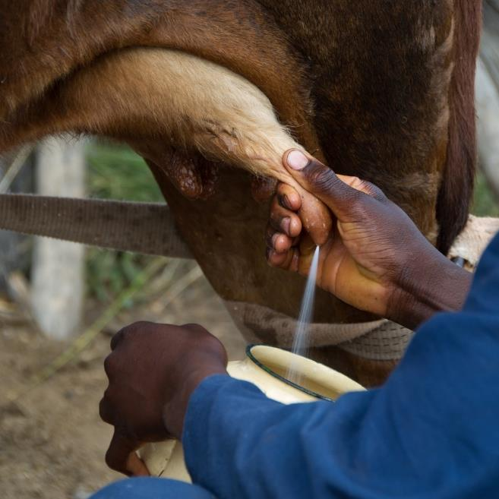
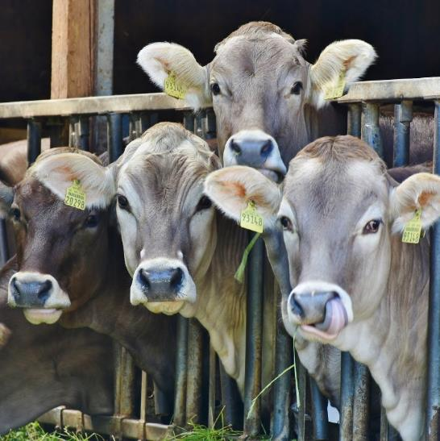
Milking the Cows
Cows need to be milked every day.

Slide 9
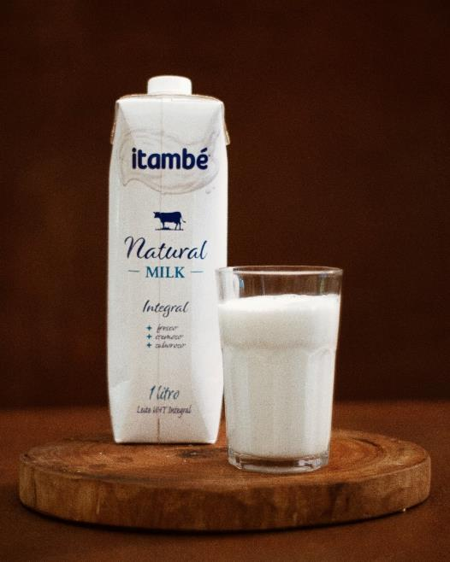
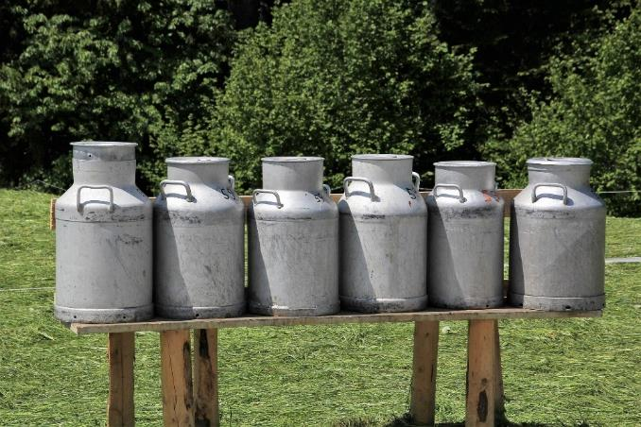
Milking the Cows
The milk is taken to be cleaned and then put into bottles.
It is then sold in shops.

Slide 10
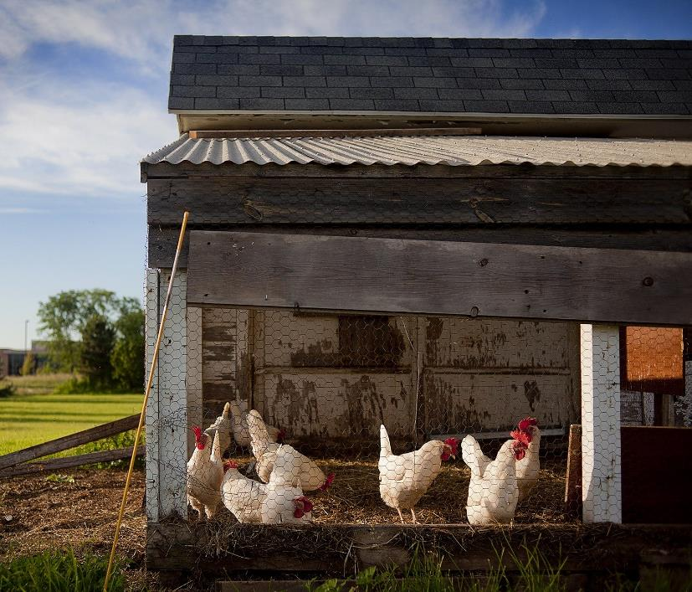
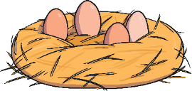
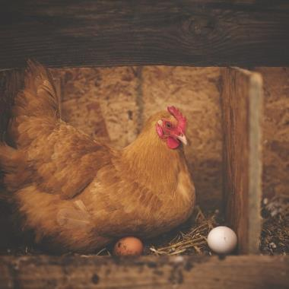
Collecting the Eggs
Most chickens lay eggs every day.

Slide 11
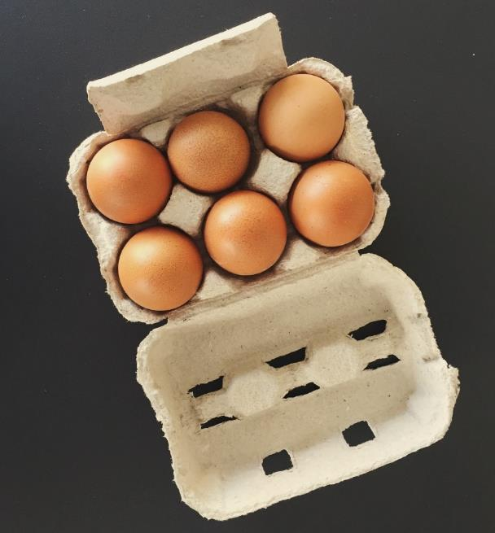
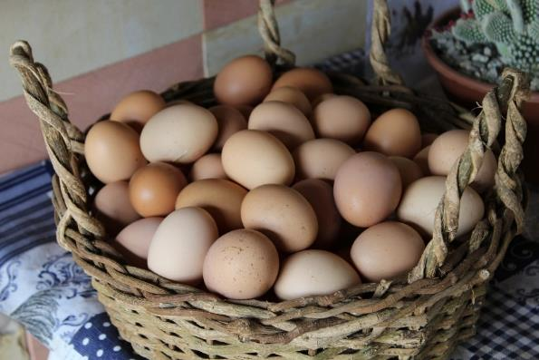
Collecting the Eggs
The eggs are collected.
They are sorted into egg boxes for customers to buy.

Slide 12
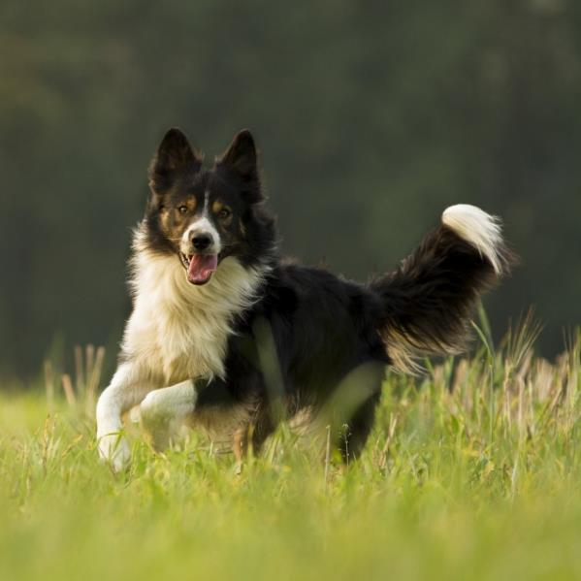
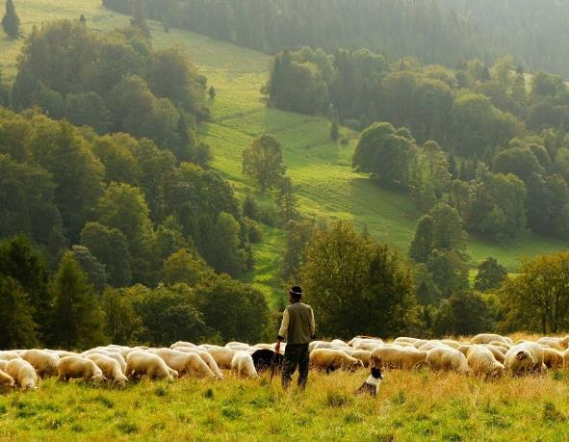
Herding the Sheep
Sheep graze on grass in the fields.
When a farmer needs to move the sheep, they might use a sheepdog to help.

Slide 13
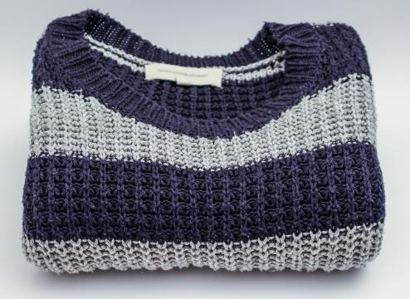
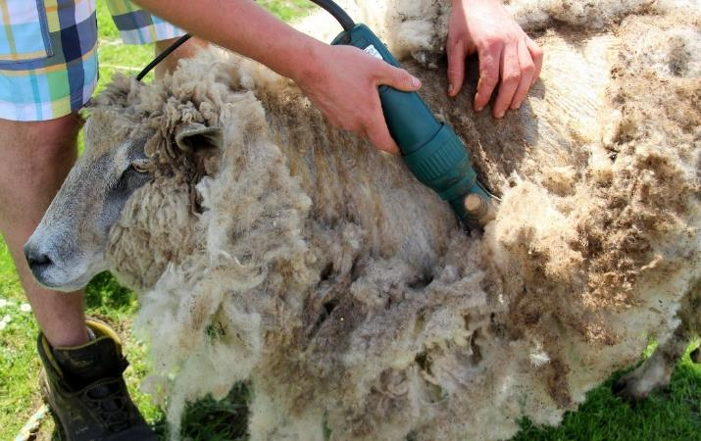
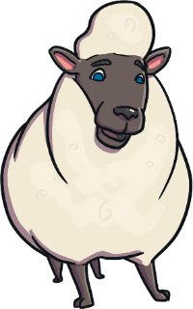
Shearing the Sheep
In the summer, farmers remove the woolly coats from the sheep.
The wool is cleaned and turned into jumpers and other clothes.

Slide 14
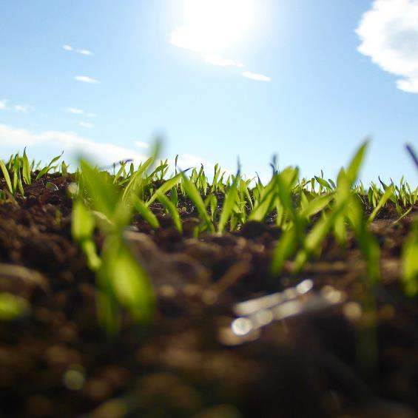
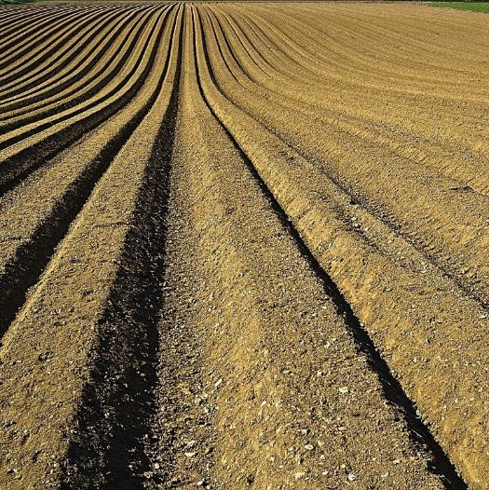
Planting the Crops
Some farms grow plants to eat, like fruit, vegetables or wheat.
The farmer plants lots of seeds in spring.
Soon, the crops start to grow.

Slide 15
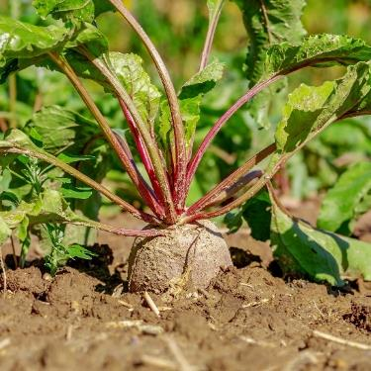
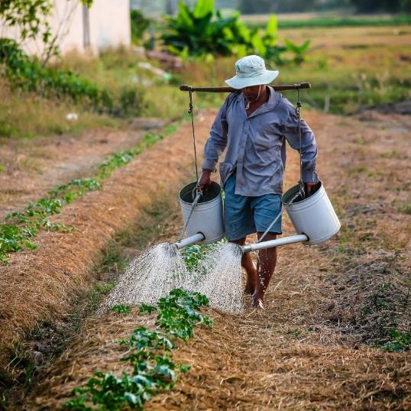
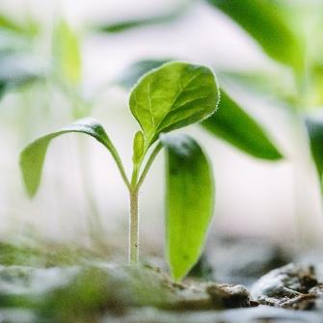
Growing the Crops
The farmer looks after the crops as they grow.
They water the crops.
In time, the crops will be ready to harvest.

Slide 16
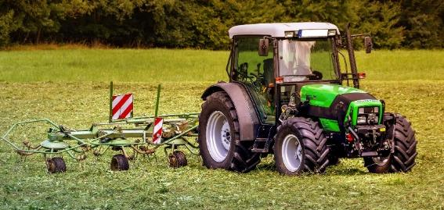
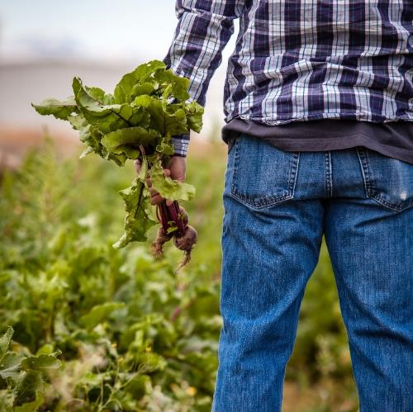
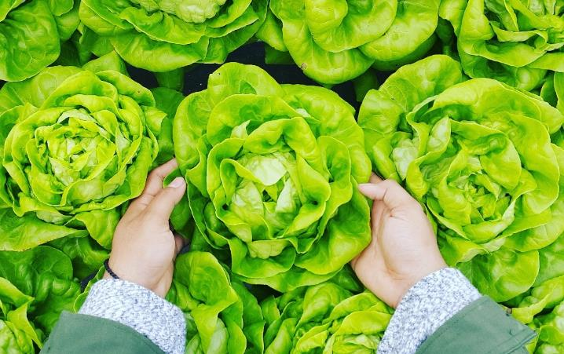
Harvesting the Crops
When the crops are ready, the farmer harvests them with their hands or with a machine.

Slide 17
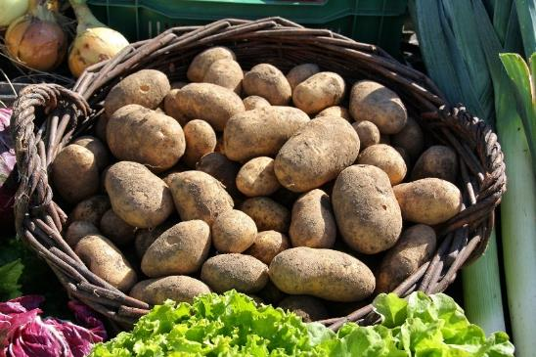
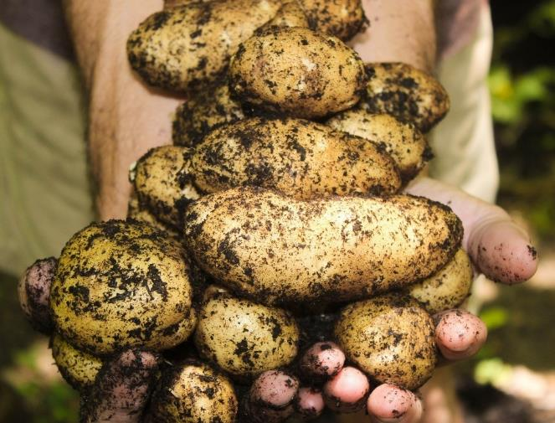
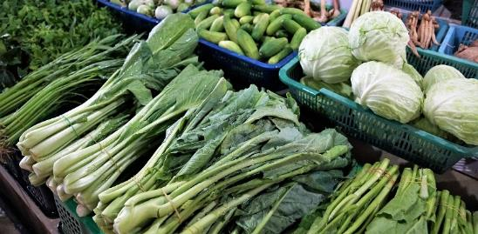
Harvesting the Crops
The food is collected and cleaned.
It is then taken to shops or markets and sold.

Slide 18
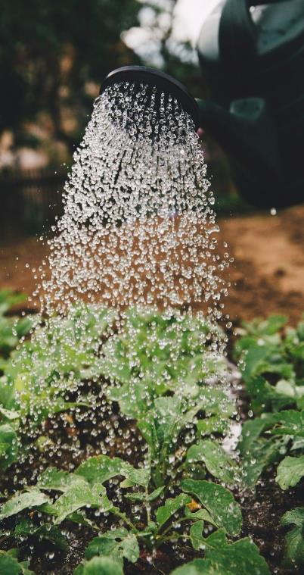
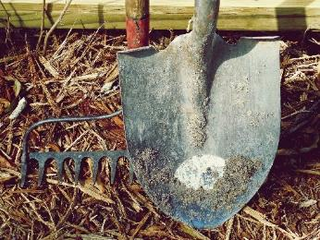
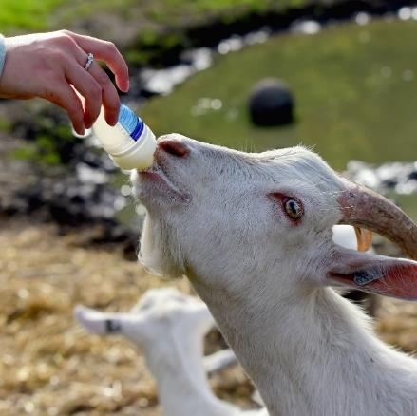
A Job for You?
Would you like to be farmer?
Which jobs on the farm would you like to do?

