Slide 1
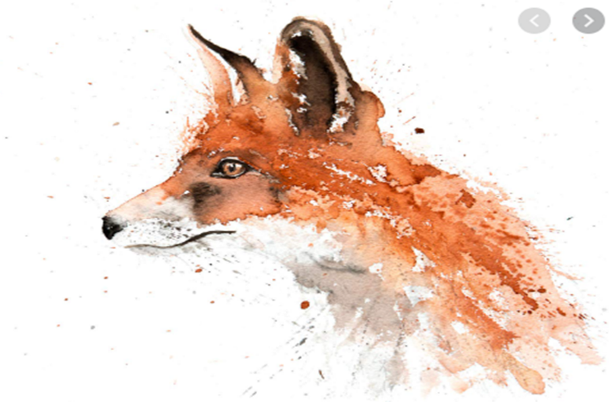
Brookfields @The Grange Satelite Provision

Slide 2
Foxes Classroom

Slide 3
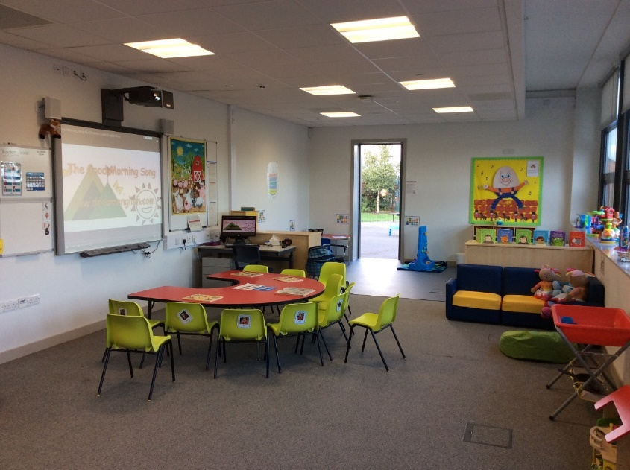
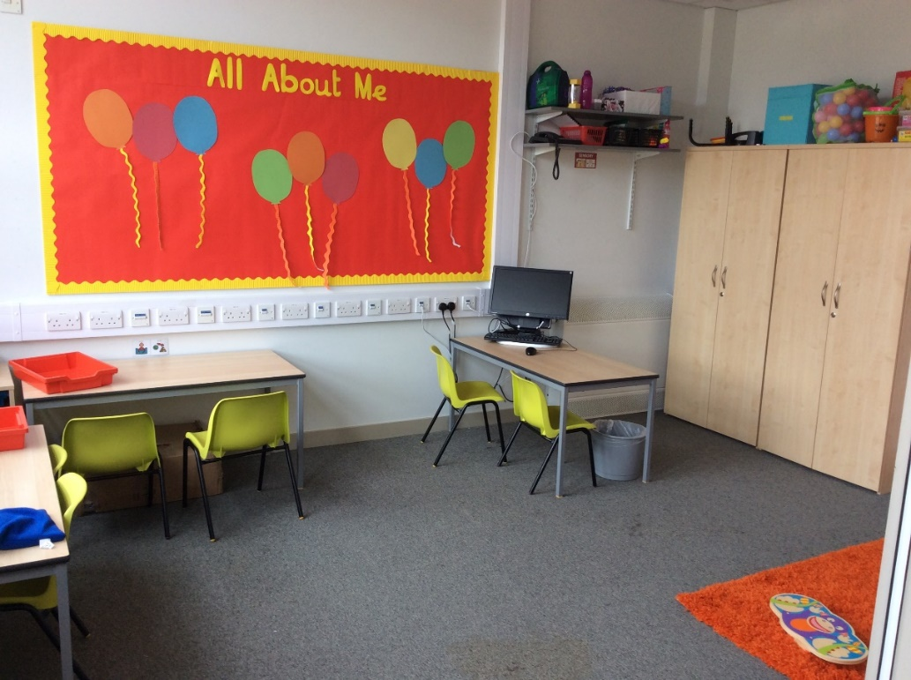
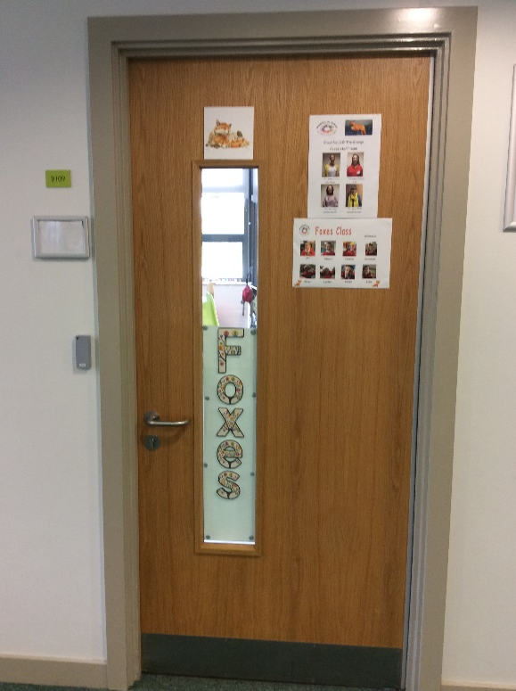

Slide 4
Bees Classroom

Slide 5
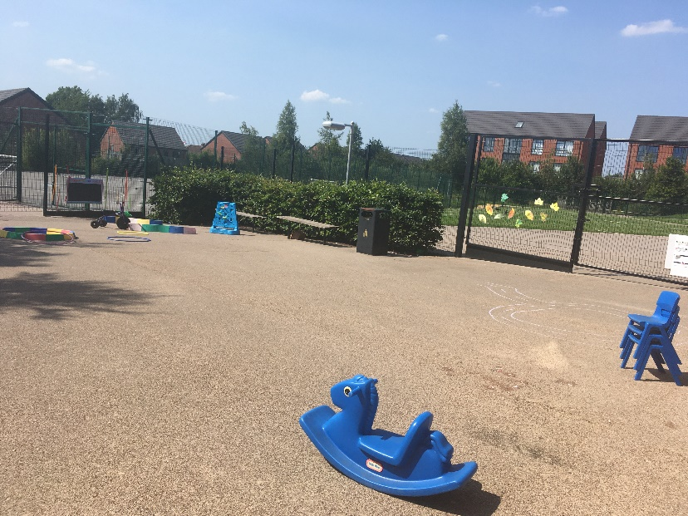
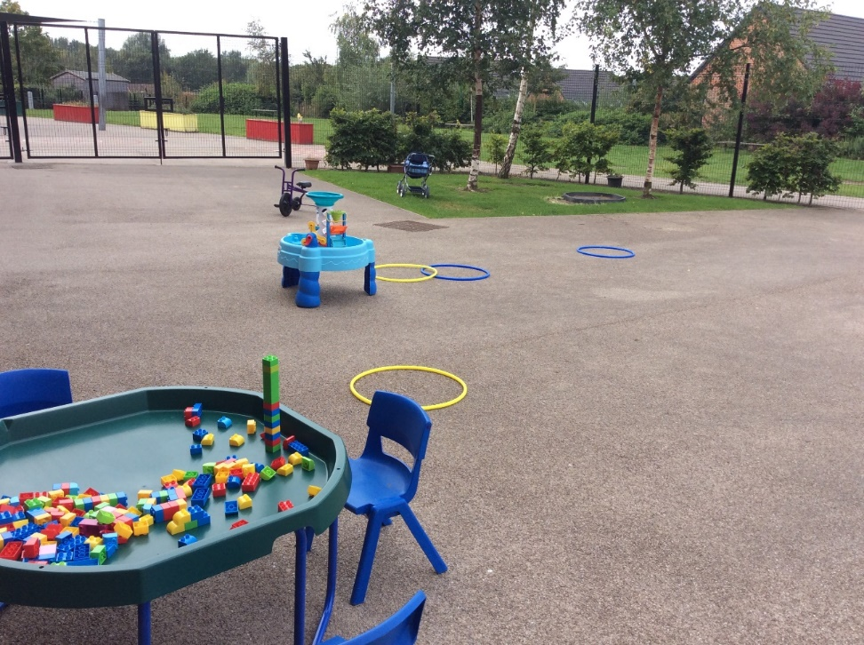
Outside space

Slide 6
We share learning spaces with The Grange resource base pupils

Slide 7
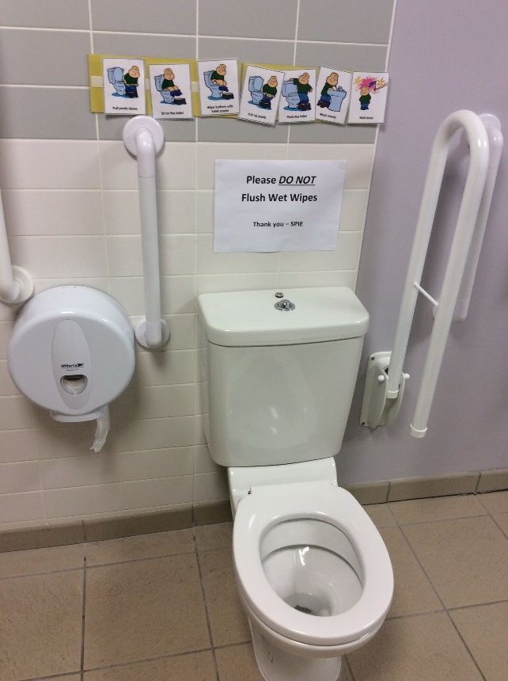
Bathroom: Brookfields have access to our own bathroom and changing area which contains storage for nappies and a lower size toilet for toilet training. There is also large mirror in this room which is used for self help skills such as brushing hair and teeth. Symbols are used to support toilet training routines.

Slide 8
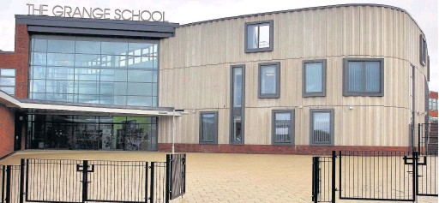
The Grange School Although the building looks big please be reassured that we are in a small and secure areas and that we have different school start and end times in our day to the Grange pupils.

Slide 9
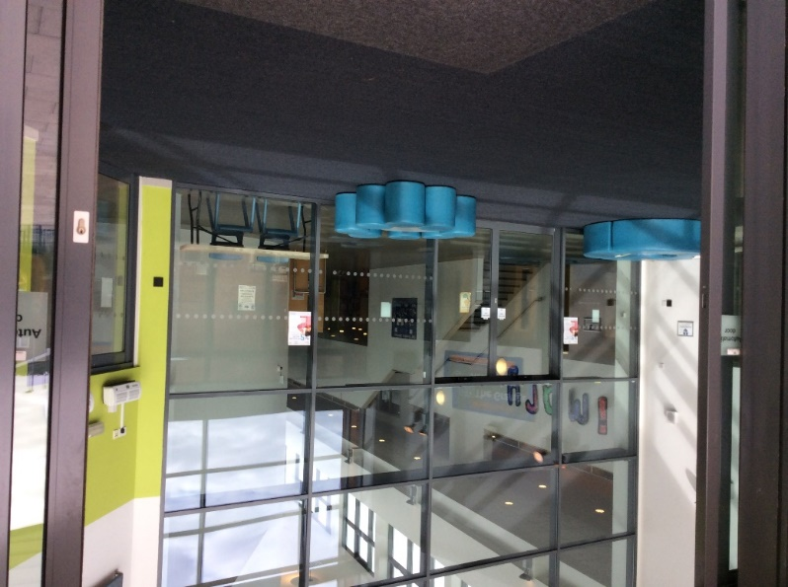
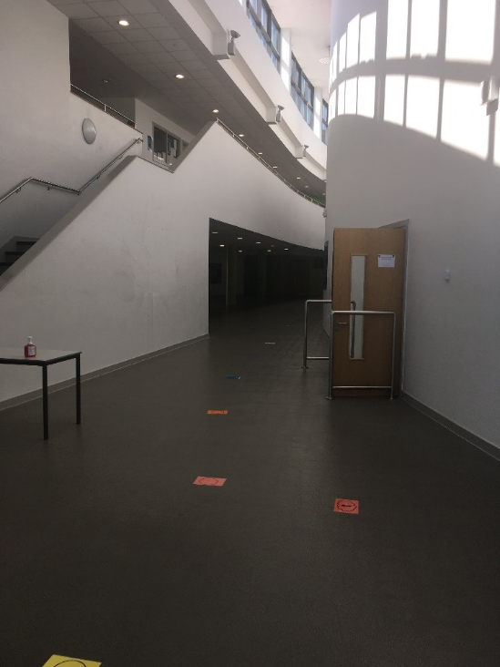
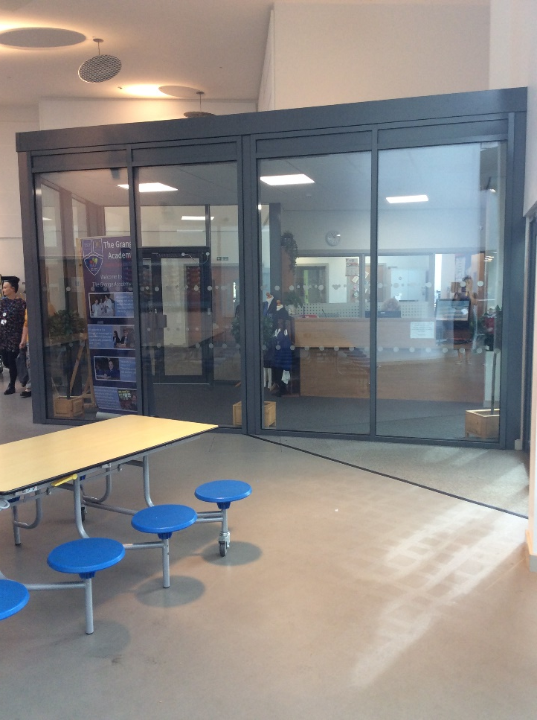
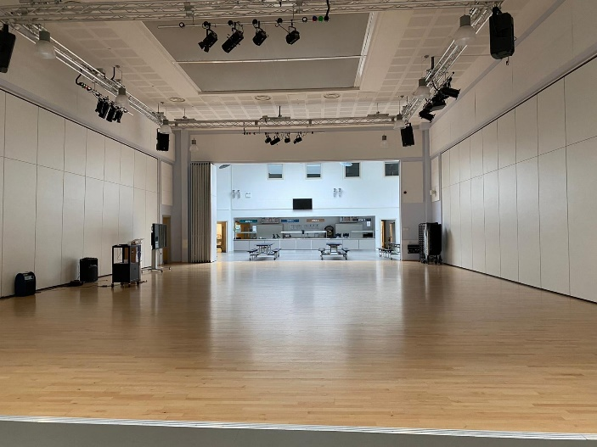
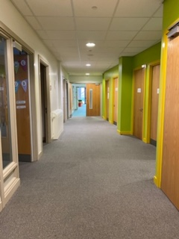
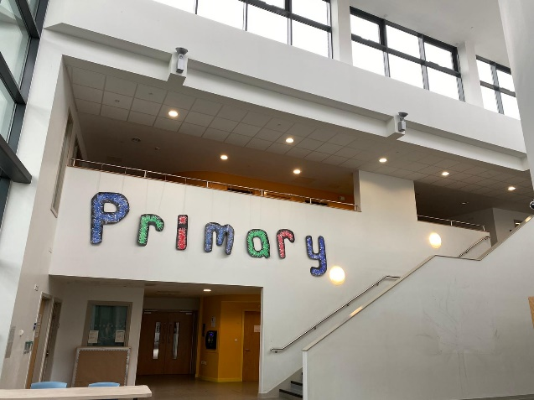
Come on inside….the children love to explore around the school [safely with the class team]

Slide 10
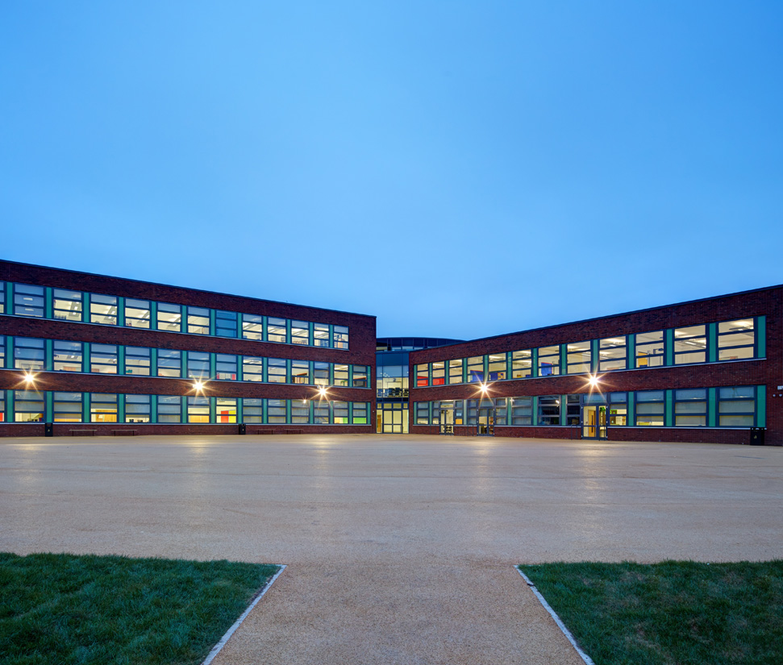
Although it looks to be a big school, Brookfields children feel happy, safe and secure within our provision area that is secure with Fob systems and our own playground.
Foxes and Butterflies classes are here in this area

Slide 11
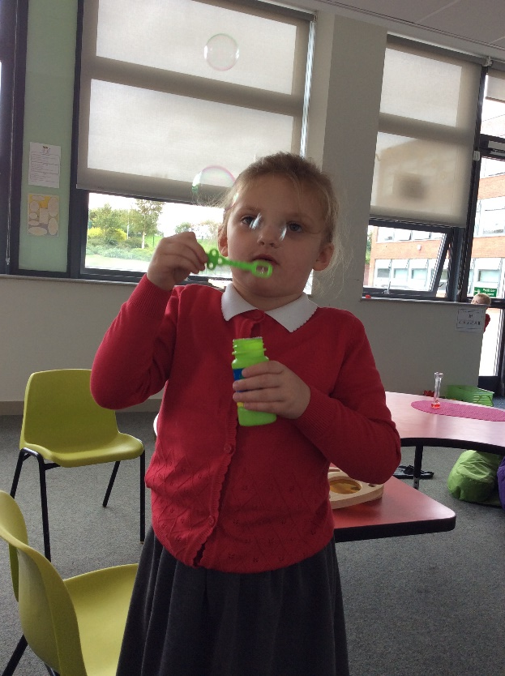
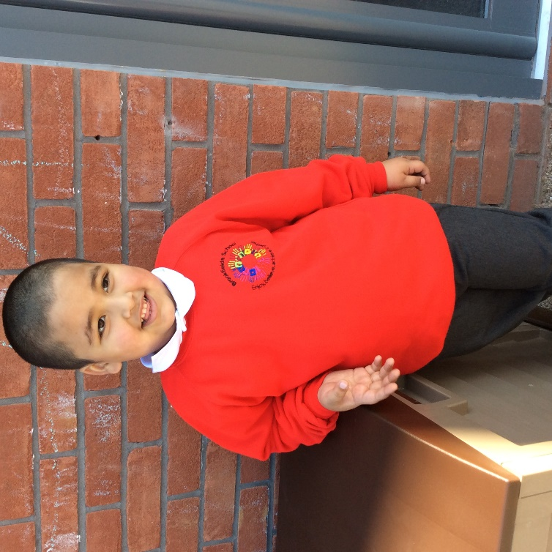
Brookfields pupils wear uniform like this

Slide 12
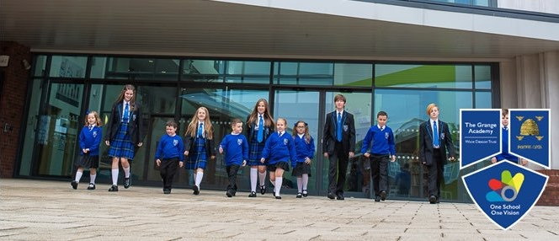
The grange pupils wear uniform like this]

