Slide 1
Maths Day
July 2015

Slide 2
There are lots of Maths challenges to complete around school today.
Here are some of the challenges you might do:-

Slide 3
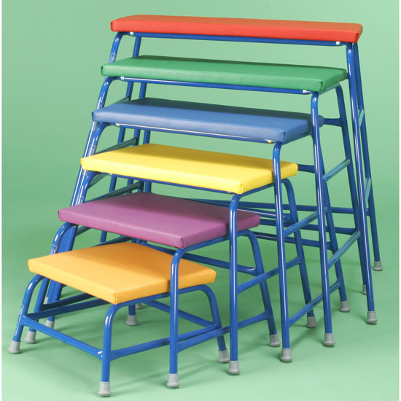
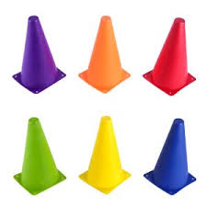
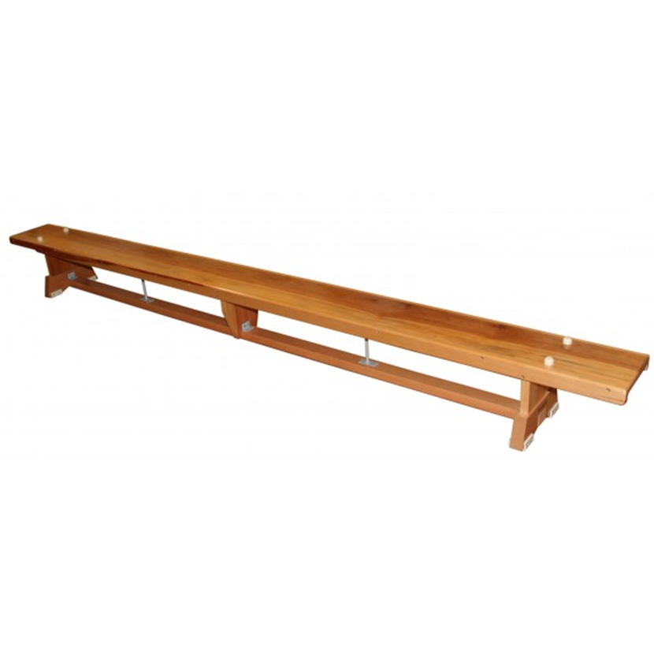
Use the apparatus to go:- On, off, over, under, through, next to, on top.

Slide 4
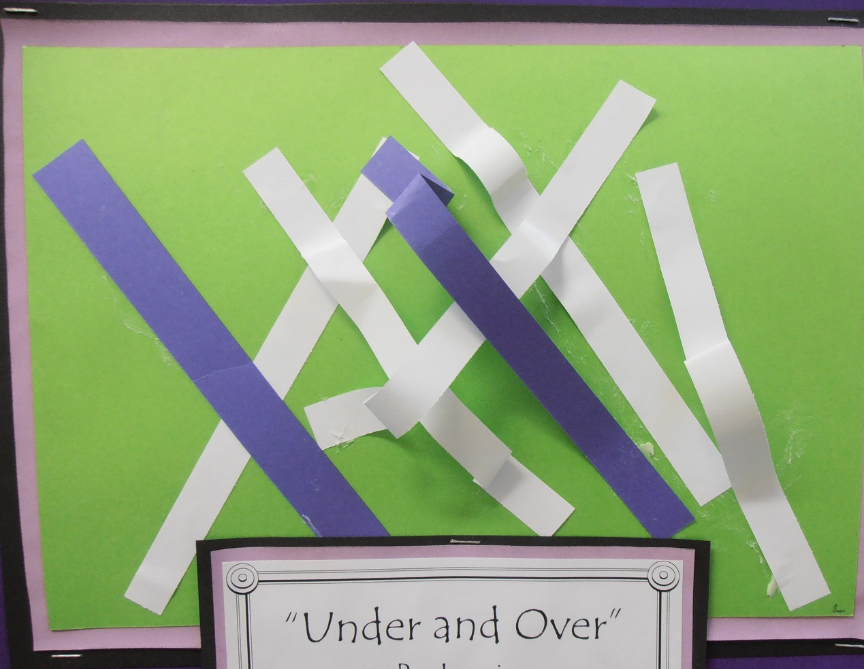
Make an ‘under’ and ‘over’ picture.

Slide 5
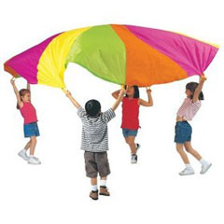
Lift the parachute ‘up’ and ‘down’.
Move the parachute ‘faster’ and ‘slower’.

Slide 6
Stretch ‘forwards’ and lean ‘backwards’. Step ‘in’, step ‘out’.

Slide 7
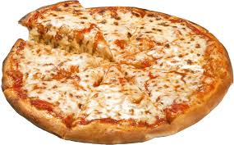
Make your own pizza.
Follow the instructions to find out what you need to do.

Slide 8
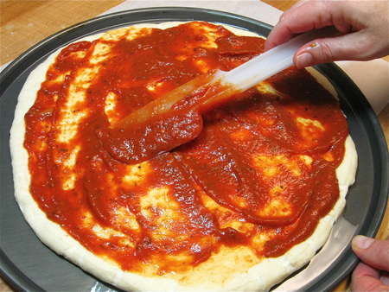
1st Spread on the tomato puree.

Slide 9
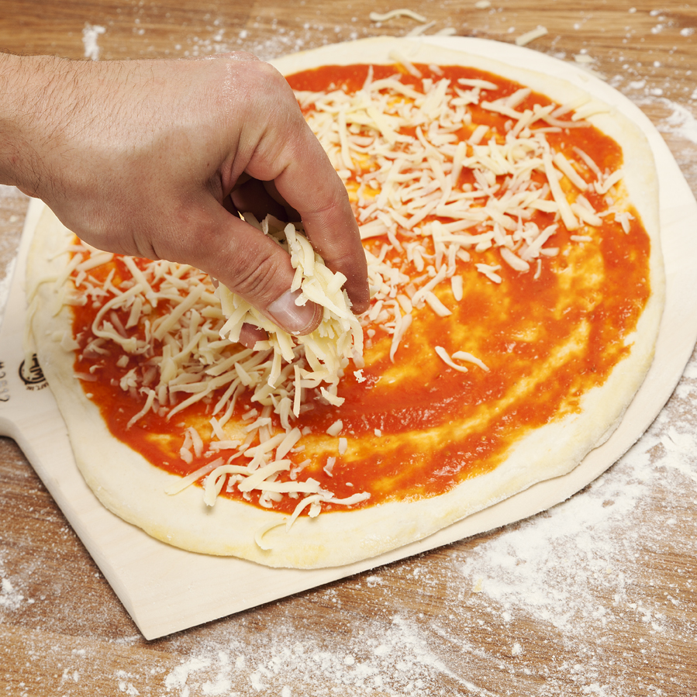
2nd Sprinkle on the cheese.

Slide 10
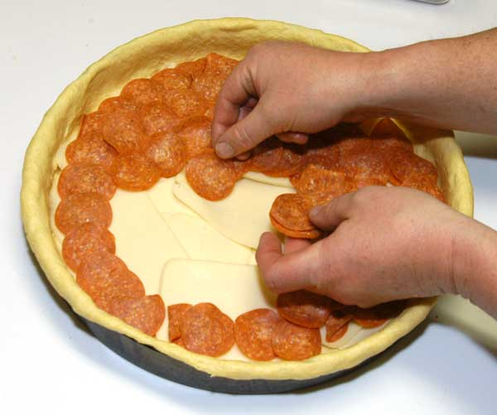
3rd Put on the topping.
Choices of toppings may include ham, peperoni, tomato

Slide 11
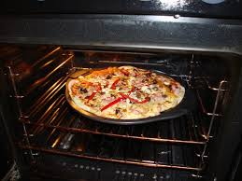
4th Cook the pizza in the oven

Slide 12
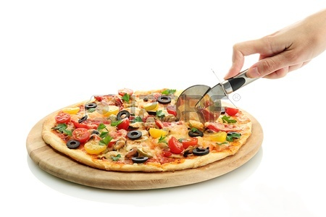
5th Cut the pizza.
Challenge ~ Work out how many pupils are in the class and how many pieces you will need.

Slide 13
6th Eat the pizza.

Slide 14
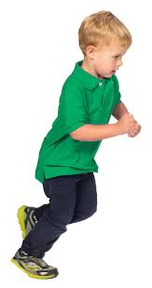
Play the ‘stop’ and ‘go’ game.

Slide 15
Hope you all work hard and enjoy the maths challenges and have fun!

