Slide 2
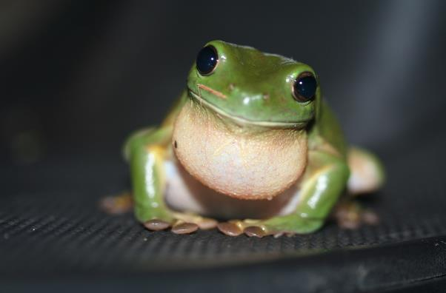
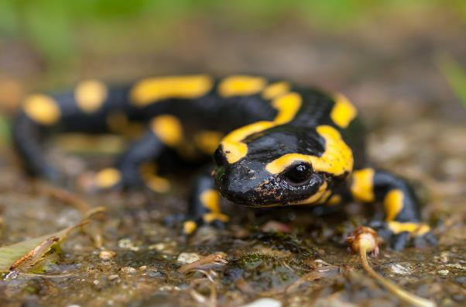
Amphibians
Note the similarities and differences between them.
frog
Amphibians live on land and in water. They lay their eggs in water.
salamander
Photo courtesy of wwarby, httpwwwflickrcomphotostopend (@flickr.com) - granted under creative commons licence - attribution

Slide 3
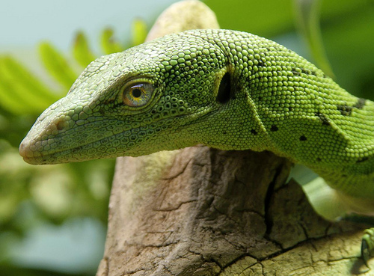
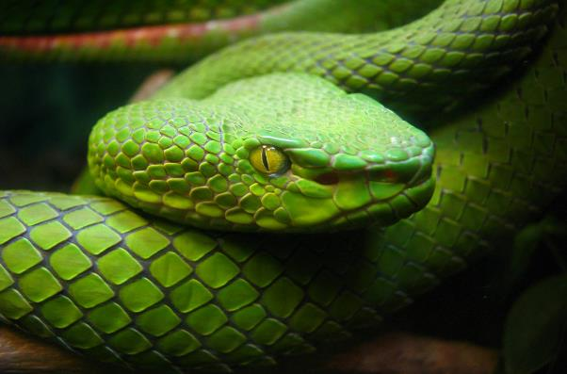
Reptiles
Note the similarities and differences between them.
lizard
Reptiles live in water and on land.
They have scales and are cold blooded. This means that they cannot keep warm by themselves and need to be in a warm place.
They lay their eggs on land.
snake
Photo courtesy of wwarby, httpwwwflickrcomphotostopend (@flickr.com) - granted under creative commons licence - attribution

Slide 4
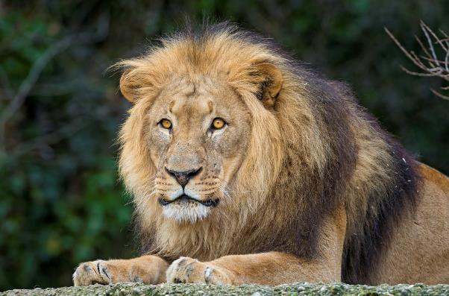
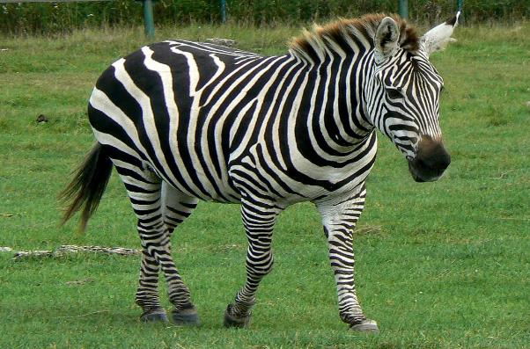
Mammals
Note the similarities and differences between them.
lion
Mammals usually have hair or fur.
Mammal babies are born alive.
The mothers feed their babies milk.
We are mammals.
zebra
Photo courtesy of vickispix, tambako(@flickr.com) - granted under creative commons licence - attribution

Slide 5
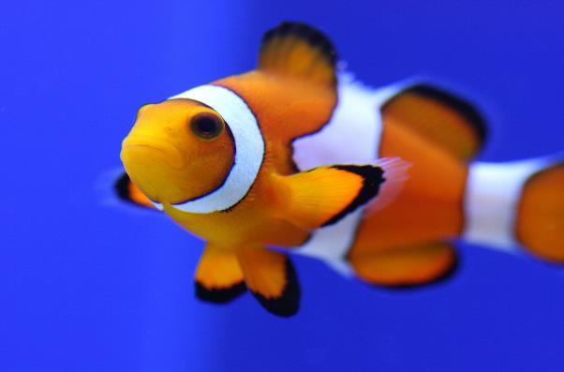
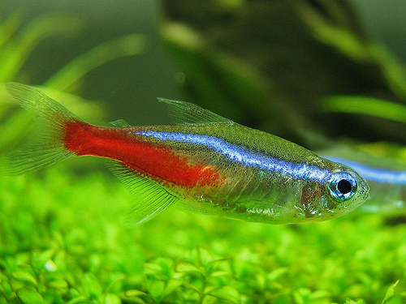
Fish
Note the similarities and differences between them.
Clown Fish
Fish live in water.
They have fins instead of legs and gills instead of lungs. They lay their eggs in water.
Neon Tetra
Photo courtesy of 24242453@N07, nathaninsandiego (@flickr.com) - granted under creative commons licence - attribution

Slide 6
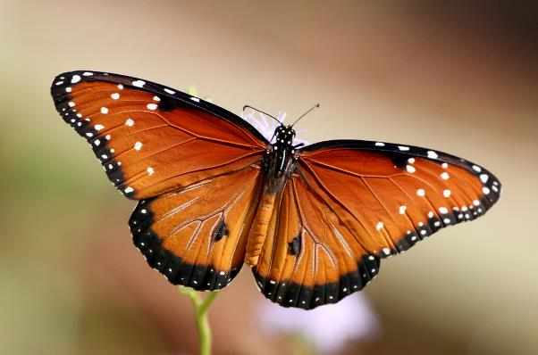
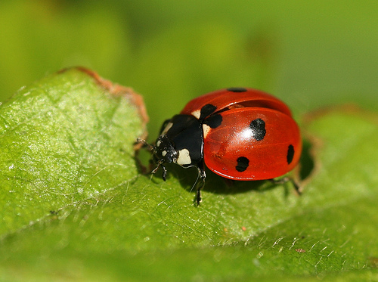
Insects
Note the similarities and differences between them.
butterfly
Insects have 6 legs.
Their bodies are made up of 3 parts. Some have wings.
They lay eggs.
ladybird
Photo courtesy of texaseagle, photos/rachel_s (@flickr.com) - granted under creative commons licence - attribution

Slide 7
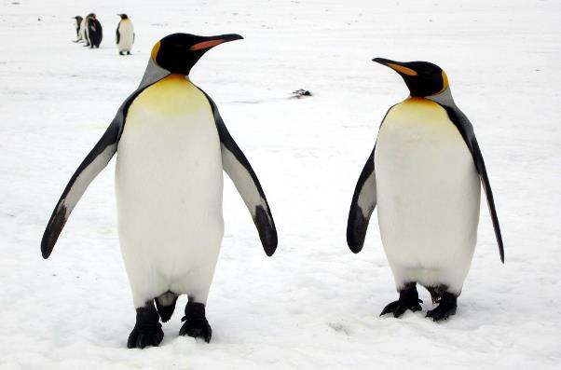
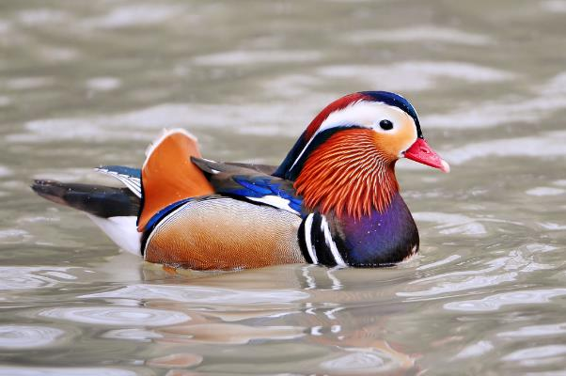
Birds
Note the similarities and differences between them.
penguins
Birds have a beak, wings, feathers and 2 legs. They lay eggs.
Mandarin Duck
Photo courtesy of davidstanleytravel, tambako (@flickr.com) - granted under creative commons licence - attribution

